Slide 1



School Improvement Grant (SIG) Intervention Models
A webinar series prepared by the Center on Innovation & Improvement for use by the regional comprehensive centers and state education agencies to inform local education agencies.

Slide 2
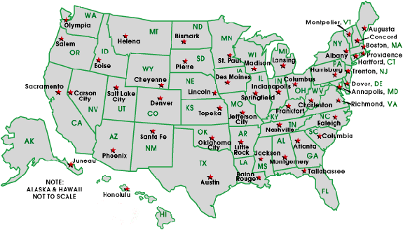
National Network of State School Improvement Leaders (NNSSIL)
Mission
To provide collegial support among state leaders of school improvement to build, utilize and disseminate a robust body of knowledge of professional practices leading to systemic educational change.
Membership
50+ SEAs and territories
16 Regional Comprehensive
Centers (RCCs)
CII & CCSSO as administrative
partners
For more information: http://www.centerii.org/leaders

Slide 3
COMPREHENSIVE TECHNICAL ASSISTANCE CENTERS
The U.S. Department of education supports a system of “comprehensive technical assistance centers” consisting of 16 regional centers and five national content centers. These centers provide technical assistance primarily to state education agencies, with the regional centers directly serving the states in their regions and the content centers providing expertise, materials, and tools to aid the regional centers in their work.
NATIONAL CONTENT CENTERS
Assessment and Accountability Comprehensive Center
Center on Innovation & Improvement
Center on Instruction
National Comprehensive Center for Teacher Quality
National High School Center
For directory of the centers
see: www.centerii.org
REGIONAL COMPREHENSIVE CENTERS
Alaska Comprehensive Center
Appalachia Region Comprehensive Center
California Comprehensive Center
Florida & Islands Comprehensive Center
Great Lakes East Comprehensive Center
Great Lakes West Region Comprehensive Center
The Mid-Atlantic Comprehensive Center
Mid-Continent Comprehensive Center
New England Comprehensive
New York Comprehensive
North Central Comprehensive Center
Northwest Regional Comprehensive
Pacific Comprehensive Center
Southeast Comprehensive
Southwest Comprehensive Center
Texas Comprehensive Center

Slide 4

Featured Presenter
Lauren Morando Rhim
Member, Scientific Council, Center on Innovation & Improvement
and Education Consultant

Slide 5
The Restart Model
March 2010
Lauren Morando Rhim
LMR Consulting

Slide 6
WEBINAR OVERVIEW
Definition/scope of the school restart model
Theory of action underlying the restart model
Strategies to maximize impact of school restart
Timelines
Pitfalls to avoid
Guiding questions
Key resources

Slide 7
DEFINITION: SCHOOL CHANGE STRATEGIES
Turnaround
Restart
Closure
Transformation

Slide 8
DEFINITION: RESTART MODEL
LEA converts a school or closes and reopens a school under a charter school operator, a charter management organization (CMO), or an education management organization (EMO) that has been selected through a rigorous review process.
A restart model must enroll, within the grades it serves, any former student who wishes to attend the school.
A rigorous review process could take such things into consideration as an applicant’s team, track record, instructional program, model’s theory of action, sustainability.
As part of this model, a State must review the process the LEA will use/has used to select the partner.

Slide 9
DEFINITION: CHARACTERISTICS OF RESTART
Across-the-board change
Authority to do things differently
Based upon a relationship outlined in a performance contract

Slide 10
DEFINITION: RESTART MODEL OPTIONS
Restart School
Converts to charter
Charter School Board
Independent Operator
Education Management Organization
Performance contract
Education Management Organization
Charter Management Organization
Charter Management Organization

Slide 11
THEORY OF ACTION
Starting fresh allows a state, district, or other authorizing entity to break the cycle of low achievement by making deep and fundamental changes to the way the school operates
Source: National Association of Charter School Authorizers (2005). Starting Fresh Series

Slide 12
STRATEGIES: CREATE NEW SCHOOL CULTURE SUPPORTING EFFECTIVE INSTRUCTIONAL PRACTICE
To realize the full potential of restarting low-achieving schools, states/districts must:
define explicit expectations for performance;
empower high capacity school leaders to make dramatic changes absent avoidable intrusion from external governing bodies (e.g., state, school district, or authorizer);
create a positive new school culture that will catalyze success;
recruit and retain skilled and committed educators to the schools and classrooms with the greatest need; and
satisfy and engage parents in order to keep them in public schools.
Source: National Association of Charter School Authorizers (2005). Starting Fresh Series

Slide 13
STRATEGIES: PLANNING CHECKLIST
Allocate time to plan / prepare
Establish rigorous selection process
Recruit and select highly skilled providers/leaders
Board and/or EMO/CMO-level
School level (principal / CEO)
Establish conditions to support restart
Freedom to act
Staff aligned with mission / approach
Engage parents and community
Implement effective instructional practices and rigorous performance accountability

Slide 14
STRATEGIES: ESTABLISH RIGOROUS SELECTION PROCESS
Rubric to assess CMO/EMO quality*
Academic?
Fiscal and operational?
Potential?
*Adapted from Rhim, L. M. (2009). Charter School Replication: Growing a Quality Charter School Sector. National Association of Charter School Authorizers

Slide 15
STRATEGIES: RUBRIC TO ASSESS CMO/EMO ACADEMIC ACHIEVEMENT
What is the CMO/EMO’s academic performance relative to local and state averages?
Has the CMO/EMO demonstrated student academic growth over time, particularly among student populations similar to the target population for the proposed replication?
Has the CMO/EMO demonstrated improved graduation rates and readiness for post-secondary education?
What is the post-secondary success rate of graduates of CMO/EMO schools?
Is there evidence of unmet demand for the school model (e.g., waitlists)?

Slide 16
STRATEGIES: RUBRIC TO ASSESS CMO/EMO FISCAL AND OPERATIONAL RECORD
Does the CMO/EMO have a track record of successfully recruiting high-quality school leadership and instructional personnel?
Has enrollment in schools operated by the CMO/EMO been stable or grown over time?
Does the application from the CMO/EMO include evidence of a well-functioning governance board or boards?
Has the CMO/EMO met state and federal financial reporting requirements in the states in which it operates?
Does the CMO/EMO’s most recent fiscal audit indicate positive financial health?

Slide 17
STRATEGIES: RUBRIC TO ASSESS CMO/EMO POTENTIAL
Plan for sustainable growth?
Specific projections regarding anticipated growth?
Rational plan reflecting awareness of key policy issues and potential challenges?
Appropriate performance expectations based on evidence?
Skilled and stable management team charged with leading restart effort?
Practical plan to create pipeline of teachers and leaders?
Evidence of Successful Transferability?
Corporate mission and vision statement?
Evidence based educational model reflecting best practice?
Coherent corporate voice regarding school model reflecting clear company culture?
Capacity to provide professional development to support school model?
Plan to train all new school personnel on an ongoing basis?
Means to track fidelity of implementation of school model?

Slide 18
STRATEGIES: DISTRICT ROLE
18
Cultivate supply of restart providers (e.g., non-profits, charter operators, IHE)
Attract restart providers (e.g., EMO/CMO’s with track record of success)
Develop rigorous selection criteria
Negotiate relationship terms
Hold providers accountable for outcomes
Extend freedom to act
3/5/2010

Slide 19
STRATEGIES: PERFORMANCE ACCOUNTABILITY CHECKLIST
Establish clear, measurable, and achievable student achievement and organizational performance goals;
Collect a tangible body of evidence;
Establish process for evaluation that includes examining academic, organizational, financial and compliance data;
Develop data gathering and reporting cycle;
Articulate consequences for failure to meeting performance targets
Prepare to retry if restart falters, and
Develop criteria for renewal or revocation of the contract.

Slide 20
SIG GRANT TIMELINE
20
March-April ’10
May ’10
Feb ’10
Feb 2010 SEAs’ SIG applications due to ED
Fall ’10
LEA application process
ED awards SIG grants to States
SEA awards grants to LEAs
LEAs begin implementation
SIG schools open/reopen

Slide 21
FAST TRACK- AND EXTENDED- PLANNING RESTART
Fast - Track Planning Restart
March – September
Extended Planning Restart
September - September

Slide 22
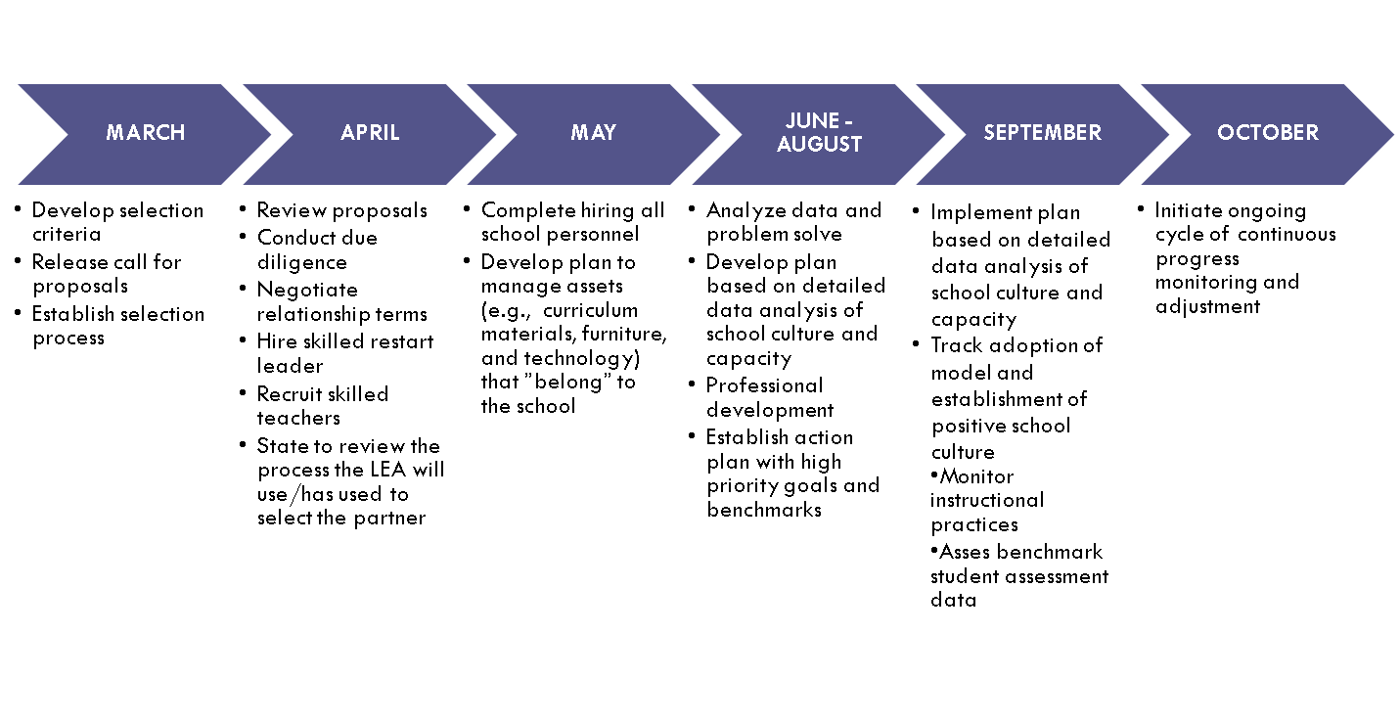
FAST-TRACK RESTART TIMELINE

Slide 23
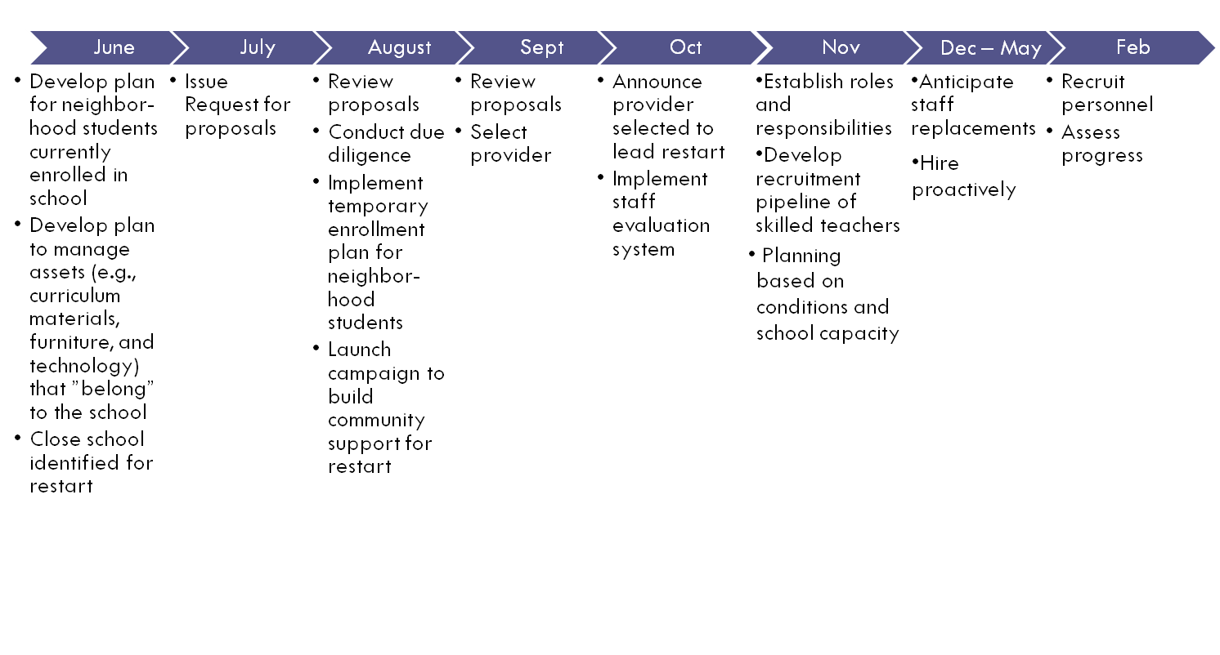
EXTENDED PLANNING RESTART TIMELINE

Slide 24
POLICY PITFALLS TO AVOID
Weak charter statute that limits charter schools’ operational autonomy
Language requiring majority of teachers to approve conversion to charter status
Inequitable charter school funding statutes
Prescriptive district procurement procedures that preclude merit-based selection of restart providers
Inhibiting autonomy that leads to inhibiting implementation of CMO/EMO or charter school model

Slide 25
PRACTICAL PITFALLS TO AVOID
“Conventional wisdom” about degree of prescription outlined in collective bargaining agreements
Weak/bureaucratic—as opposed to performance based—provider selection procedures
Ambiguous relationship terms
Undefined accountability metric
Absence of consequences for failure to meet performance goals
Failure to consistently implement effective instructional practices

Slide 26
GUIDING QUESTIONS
What policy barriers may impede efforts to leverage the restart approach?
What steps are required to cultivate a pipeline of restart providers?
How can I leverage federal funding to stimulate a supply of restart providers?
Is the statewide system of support aligned to scaffold restart efforts?

Slide 27
RESOURCES
The Center for Comprehensive School Reform and Improvement. (2009). School restructuring, What works when? A guide for education leaders. Washington, DC: Learning Points Associates. Retrieved from http://www.centerforcsri.org/files/School_Restructuring_Guide.pdf
Hassel, B. C., & Hassel, E. A. (2005). Starting fresh in low-performing schools: A new option for school district leaders under NCLB. Chicago, IL: National Association of Charter School Authorizers. Retrieved from http://www.qualitycharters.org/i4a/pages/Index.cfm?pageID=338
Kowal, J.M., & Arkin, M.D. (2005). Contracting with external education management providers. In Learning Points Associates, School restructuring options under No Child Left Behind: What works when? Naperville, IL: Author. Retrieved from http://www.ncrel.org/csri/resources/ncrel/knowledgeissues/Contracting.pdf
National Association of Charter School Authorizers. (2005, July.) Resource toolkit for working with education service providers. Chicago, IL: Author. Retrieved from http://www.qualitycharters.org/files/public/ESPToolkit2005.pdf
National Association of Charter School Authorizers (2009). Principles and standards for quality charter school authorizing: Revised edition. Chicago, IL: Author. Retrieved from http://www.qualitycharters.org/files/public/Principles_and_Standards_2009.pdf

Slide 28
RESOURCES
National Charter School Research Project (2007, August). Quantity counts: The growth of charter school management organizations. Seattle, WA: Center on Reinventing Public Education.
National Resource Center on Charter School Finance and Governance (2010). Empowering teachers through a CMO-created union. Washington, DC: Author. Retrieved from http://www.charterresource.org/
National Resource Center on Charter School Finance and Governance (2010). Implementing an in-house approach to teacher training and professional development. Washington, DC: Author. Retrieved from http://www.charterresource.org/
National Resource Center on Charter School Finance and Governance (2010). Mapping the landscape of charter management organizations: Issues to consider in supporting replication. Washington, DC: Author. Retrieved from http://www.charterresource.org/
National Resource Center on Charter School Finance and Governance (2010). Scaling up charter management organizations: Eight key lessons for success. Washington, DC: Author. Retrieved from http://www.charterresource.org/
Perlman, C. L., & Redding, S. (Eds). (2010). Handbook on effective implementation of school improvement grants. Lincoln, IL: Center on Innovation & Improvement. Retrieved from http://www.centerii.org/survey
Redding, S. (2006). The mega system: Deciding. Learning. Connecting. Lincoln, IL: Academic Development Institute. Retrieved from www.centerii.org/survey

Slide 29
RESOURCES
29
Redding, S. (2010). Selecting the intervention model and partners. Lincoln, IL: Center on Innovation & Improvement. Retrieved from www.centerii.org/survey
Redding, S., & Walberg, H. (Eds.). (2008). Handbook on statewide systems of support. Lincoln, IL: Center on Innovation & Improvement. Retrieved from www.centerii.org/survey
Rhim, L. M. (2009). Charter School Replication: Growing a Quality Charter School Sector. National Association of Charter School Authorizers. http://www.qualitycharters.org/files/public/Charter_School_Replication_Policy_Guide.pdf
Rhim, L. M., & Brinson, D. (2010). Retrofitting bureaucracy: Factors influencing charter schools’ access to federal entitlement programs. Lincoln: ILThe Center on Innovation & Improvement. Retrieved from http://www.centerii.org/survey
Walberg, H. J. (Ed.). (2007). Handbook on restructuring and substantial school improvement. Lincoln, IL: Center on Innovation and Improvement. Retrieved from www.centerii.org/survey
Prepared for NNSSIL by Center on Innovation & Improvement and Council of Chief State School Officers
3/5/2010
Notes:
29

Slide 30
FURTHER QUESTIONS….
30
http://www.centerii.org/
Webinar citation:
Center on Innovation & Improvement (Writer, Producer), & Council of Chief State School Officers (Producer). (2010, March). School improvement Grant (SIG) intervention models: The restart model. [audiovisual recording]. Prepared for the National Network of State School Improvement Leaders. Lincoln, IL: Center on Innovation & Improvement. Retrieved from http://www.centerii.org/

