Slide 1
Rubrics-Based Evaluation of a Statewide System of Support
A Tool to Enhance Statewide Systems of Support

Slide 2
Purpose
To present a framework for how a State Education Agency (SEA) can evaluate the capacity, operational efficiency, and effectiveness of its Statewide System of Support (SSOS).
For guiding an SEA’s internal evaluation of its SSOS or its development of specifications for an external evaluation.
In establishing ongoing monitoring, reporting, and formative evaluation processes for an SEA’s SSOS.

Slide 3
Development of the SSOS Evaluation Rubrics
Basis-A Framework for Effective Statewide Systems of Support developed by Rhim, Hassel, and Redding
Research on roles of states in school improvement, including case studies of five State Education Agencies and surveys of all 50 states, Washington DC and Puerto Rico.
Intensive work with a pacesetting group of 9 states.

Slide 4
Conclusions to the Research
Successful systemic reform requires incentives, capacity, and opportunities
Each SEA needs an organizational framework to document its strengths and weaknesses and for planning SSOS improvement.
There is a need for a strong, continuous, state designed and district-directed improvement process to assist schools at all levels of performance

Slide 5
Components of the Rubric-Based Evaluation
Part A: SSOS Plan and Design
1. Specified comprehensive plan for SSOS
2. Defined evidence-based programs/interventions for all students and subgroups
3. Plan for formative evaluation

Slide 6
Components of the Rubric-Based Evaluation
Part B: Resources
4. Staff
5. Funding
6. Data Analysis and Storage
7. Distinguished educators, consultants, experts, etc.
8. External providers

Slide 7
Components of the Rubric-Based Evaluation
Part C: Implementation
9. Removal of barriers
10. Incentives for change
11. Communications
12. Technical assistance
13. Dissemination of Knowledge
14. Formative evaluation and monitoring (audits)

Slide 8
Components of the Rubric-Based Evaluation
Part D: Outcomes
Student achievement
Student attendance
Graduation rate

Slide 9
Essential Indicators
Within these 4 Parts are 42 Essential Indicators that define the critical components of a State’s SSOS
Four-point rubrics with cells individualized to each of the 42 indicators help explain and define the different stages a State will go through as it successfully meets each indicator

Slide 10
Rubric Decisions
Next to each indicator there are 4 columns describing the possible continuum of progress
Little or No Development or Implementation
Limited Development or Partial Implementation
Mostly Functional level of Development and Implementation
Full Level of Implementation and Evidence of Impact

Slide 11
Sample Essential Indicator 5.1
5.1 Coordination among state and federal programs
Little or No Development of Implementation: There is no apparent plan to efficiently coordinate programs with different funding sources that are aimed at improving schools receiving SSOS services.
Limited Development or Partial Implementation: The state has a written plan and has made some preliminary attempts to integrate multiple state and federal programs aimed at school improvement.
Mostly Functional Level of Development and Implementation: The state has begun to integrate multiple programs with common goals but different funding streams in areas such as planning, resource allocation, training, reporting, and compliance monitoring.
Full Level of Implementation and Evidence of Impact: The state has fully implemented its program integration plan, and there is evidence of greater efficiency in planning, resource allocation, and compliance monitoring.

Slide 12
Cumulative Scoring
To receive a rating of III “Mostly functional level of development and implementation”, the SSOS must also fulfill the requirements to receive a rating of II “Limited development or partial implementation”.

Slide 13
Explanatory Materials Provided in the Evaluation Rubric Report
Evaluation rubric with 42 Essential Indicators
Sample ratings for each indicator along with examples of evidence to help each SEA Team rate its own SSOS
Examples from states that help explain the Indicator statements
A template for SEA Team self- scoring
Essential components of an evaluation plan

Slide 14
Determining the Rating
Essential Indicator 7.2:
Training for distinguished educators and support teams

Slide 15
What the SEA said it had accomplished
As required by the state plan, all Distinguished Educators (DE) must participate in three levels of training/professional development: (a) a one-week summer session, (b) a two-day refresher in early fall, and (c) ongoing coaching mentoring during the DE’s first year. The “DE Academy,” which delivers the training, conducts regular formative evaluations of the activities and services, using the data to make refinements as needed.

Slide 16
Determining the rating
The reviewers rated the state as operating at Level IV on this indicator. The training process for DEs was formally defined, comprehensive, fully implemented, and subjected to continuing review, evaluation and improvement.

Slide 17
State Examples Related to the Indicators*
Indicator 2.2—Coordination of services across SEA departments
The example shows how Ohio worked with the Department of Education, its own Regional Programs, and internally to model how cooperation can be accomplished so funds and requirements can be integrated.
* See the Evaluation Rubric Report for state examples for each indicator

Slide 18
Rubric-Based Evaluation Activities
The rubrics illustrate the continuum that occurs with each Indicator as States develop their SSOS.
Each State Team (using evidence) should develop a profile of how its SSOS lines up with all 42 indicators by using the Rubric’s template to note the present stage of development.
Comments should be included to note what needs to be done to improve the initial results of the self-rating.
Each State Team should choose at least six indicators for immediate action after this self-review process

Slide 19
Role of CII in this process
Each State Team should develop a plan of action including tasks, timelines and the responsibilities of each team member as they begin to turn the indicator statements into objectives.
Staff from CII will be available by webinar as well as on-site work to assist State Teams as they use the Rubric’s template to document the status of their SSOS.

Slide 20
Evaluation
Each SEA Team should use the initial results from this rubric as baseline information
Periodically (and certainly annually) each SEA Team should check for progress on the entire rubric and specifically on those sections of the Rubric that generated recommendations.
CII staff are available to assist in any of these evaluations of SEA progress

Slide 21
The Evaluation Rubric & Indistar
The Indistar system can be used to choose indicators and document planning.
Using Indistar procedures, a team can begin the process of selecting indicators through the needs assessment, creating plans and assigning tasks to certain team members and other staff, as well as monitor the progress of the work as a whole.
To view the sample Indistar site, go to www.centerii.org and click on the Indistar login in the bottom, left corner of the page. Use the following login information… Login: ssos Password: ssos
Each state that is interested in using the online version of this tool will be given their own unique login and password.

Slide 22
The Evaluation Rubric & Indistar(cont.)
Before you will be given your unique login and password, we ask that you participate in an additional webinar for the “SSoS Online Tool Orientation Training”.
The webinar will be scheduled for May 13th at 1:00 pm CST. If you are interested in joining that webinar, please send an email to pacesetters@adi.org and we will send you the registration link.
An alternative date of May 27th at 1:00 pm CST will also be available if you cannot make the first webinar.

Slide 23
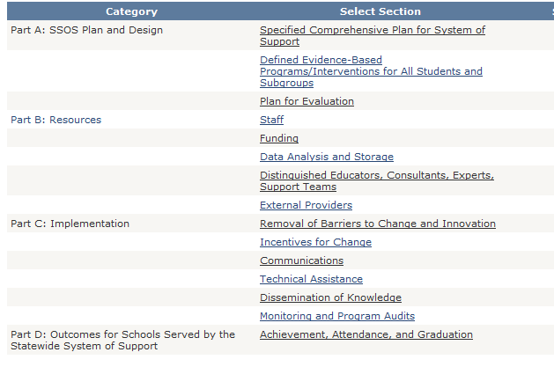
Assess….Plan….Monitor
If your State team is interested in using the Indistar Tool and would like to get an individual state login/password, please contact Stephanie Benedict, sbenedict@adi.org . For all CII support for SSoS, please contact Tom Kerins, tkerins@adi.org .

