Slide 1
Evaluating the Outcomes of SSOS:
Qualities of an Effective Evaluation
Steven M. Ross, Ph.D., Johns Hopkins University

Slide 2
Steven M. Ross, Ph.D.
Steven M. Ross is a senior research scientist and professor at the Center for Research and Reform in Education at Johns Hopkins University. Dr. Ross’ expertise is in educational research and evaluation, school reform and improvement, at-risk learners, and technology integration.

Slide 3
Questions to Ponder
Is evaluation substantively and routinely embedded in your SSOS?
Are we as states going beyond completing the rubrics and looking at root causes and data?
Do evaluation results help to scale up successful activities and discontinuing others (e.g., certain providers)?
Are external evaluators being used for support? Should they be?

Slide 4
The Evaluation Rubric : A Quick Review
Part A: SSOS Plan and Design
1. Specified comprehensive plan
2. Defined evidence-based programs
3. Plan for evaluation

Slide 5
The Evaluation Rubric : A Quick Review
Part B: Resources
4. Staff
5. Funding
6. Data analysis and storage
7. Distinguished educators, consultants, & experts
8. External providers

Slide 6
The Evaluation Rubric : A Quick Review
Part C: Implementation
9. Removal of barriers for change and innovation
10. Incentives for change
11. Communications
12. Technical Assistance
13. Dissemination of knowledge
14. Monitoring and program audits

Slide 7
The Evaluation Rubric : A Quick Review
Part D: Outcomes for Schools Served by SSOS
15. Student achievement
16. Student attendance
17. Graduation rate

Slide 8
42 Rubrics and Their Rating Scales
I. Limited or No Development or Implementation
II. Limited Development or Partial Implementation
III. Mostly Functional Level of Development and Implementation
IV. Full Level of Implementation and Evidence of Impact

Slide 9
SSOS Evaluation Rubric 2.5
2. Defined evidence-based programs/interventions for all students & subgroups
From Evaluating the Statewide System of Support, by S. Hanes, T. Kerins, C. Perlman, S. Redding, & S. Ross, 2009, p. 24, Table 2.
Copyright 2009 by Academic Development Institute. Reprinted with permission.

Slide 10
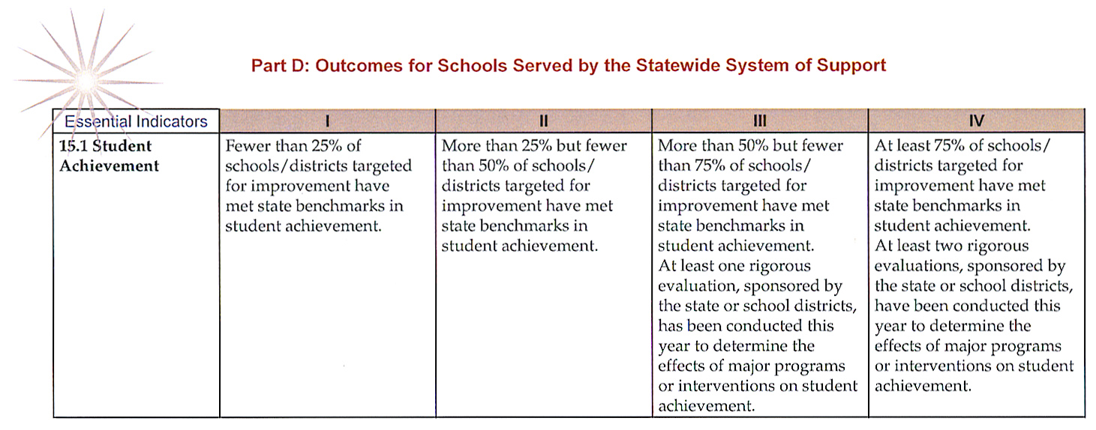
SSOS Evaluation Rubric 15.1
From Evaluating the Statewide System of Support, by S. Hanes, T. Kerins, C. Perlman, S. Redding, & S. Ross, 2009, p. 37, Table 15.
Copyright 2009 by Academic Development Institute. Reprinted with permission.

Slide 11
Why Evaluate SSOS: Isn’t There Enough to Do Already?
Being able to make reliable and valid judgments of the status of the services provided
How fully are services being implemented?
To what extent are expected outcomes being achieved?

Slide 12
Why Evaluate SSOS: Isn’t There Enough to Do Already?
To provide accountability information for SDE and external organizations
To demonstrate accountability to consumers (districts, schools, educators, parents)
To develop a process for continuous program improvement
Notes:
“Accountability” not parallel construction “-ing” with other slides in this subgroup.

Slide 13
Properties of an Effective Evaluation
Validity (rigorous, reliable)
Evidence-Based
Documented plan
Meeting agenda
Survey responses
Performance standards
Outcome measures

Slide 14
Properties of an Effective Evaluation
Strong Evidence: “80% of principals surveyed rated the Distinguished Educators’ support as very helpful and provided a specific example of how the DE helped their school.”
Weak Evidence: “The Governor touted the state’s progress in assisting low-performing schools during his tenure.”

Slide 15
Properties of an Effective Evaluation
Evaluative rather than descriptive
From Evaluating the Statewide System of Support, by S. Hanes, T. Kerins, C. Perlman, S. Redding, & S. Ross, 2009, p. 91, Table 1.
Copyright 2009 by Academic Development Institute. Reprinted with permission.

Slide 16
Evaluating Educational Outcomes
Part D, Section 15 of Rubric
SSOS is ultimately about improving student achievement and educational success
These are “distal” or “culminating” outcomes that may not show immediate change
Nonetheless, it is educationally and politically important to monitor these indicators

Slide 17
Evaluating Educational Outcomes: Recommendation 1
Treat the essential indicators (Part D, Section 15) as a starting point only
Given the 42 rubric indicators, which services appear to be the most essential to improve?
Prioritize these improvement needs

Slide 18
Evaluating Educational Outcomes: Recommendation 2
2. Supplement the essential indicators with follow-up analyses of “root causes” and data
Potentially successful turnaround strategies that may be scalable
Unsuccessful strategies that need replacement
Explanation of the outcomes relative to SSOS service provided
Example: Although we train distinguished educators and revise the training each year, what evidence is there that the training is effective?

Slide 19
Analyses of “Root Causes”
Example A: Schools showing the strongest increases in mathematics are visited by SDE and found to be using highly interactive teaching strategies and expanded learning opportunities
Implication for SSOS?

Slide 20
Analyses of “Root Causes”
Example B: School B increased its reading scores significantly over the past year. Follow-up study of student enrollment patterns reveals that student rezoning decreased the number of disadvantaged students by 50%.
Implication for SSOS?

Slide 21
Analyses of “Root Causes”
Example C: School C had several student subgroups fail to attain AYP in reading. Follow-up interviews with the principal and literacy coaches reveal that the new R/LA curriculum was poorly supported by the provider.
Implication for SSOS?

Slide 22
Evaluating Educational Outcomes: Recommendation 3
3. Supplement the beginning evaluation (Recommendation 1) and follow-up analyses (Recommendation 2) with rigorous evaluations of selected interventions
RFP’s for external studies
Assistance to school districts interested in evaluation research
Rigorous data analyses by SDE to study achievement patterns associated with SSOS interventions

Slide 23
Accurate and Relevant Evidence
Strong, Suggestive, or Weak ?
“Teachers liked the professional development activities.”

Slide 24
Accurate and Relevant Evidence
Strong, Suggestive, or Weak ?
“Systematic observation by independent observers shows significant increases in student-centered instruction.”

Slide 25
Accurate and Relevant Evidence
Strong, Suggestive, or Weak ?
“Teachers indicate that they use more student-centered instruction than in the past.”

Slide 26
Accurate and Relevant Evidence
Strong, Suggestive, or Weak ?
“Principals and grade-level leaders indicate observing more frequent cooperative learning than last year.”

Slide 27
Accurate and Relevant Evidence
Strong, Suggestive, or Weak ?
“The providers of the professional development believed the offerings to be successful.”

Slide 28
Accurate and Relevant Evidence
Strong, Suggestive, or Weak ?
“Reading scores increased by 15% for the schools receiving SSOS in literacy.”

Slide 29
Working with External Evaluators
Question: Is it more or less “costly” than using SDE staff?
Answer: It depends on the expertise and availability of the latter.

Slide 30
Working with External Evaluators
What types of evaluation tasks most need external evaluators?
The Basic Rubric (“Study I”) and the essential indicators (“Study II”) might best be performed in-house
The external evaluator (at low cost) would be helpful to corroborate the Study I and II findings
Rigorous studies of specific interventions (“Study III”) are most appropriate for external evaluators

Slide 31
Working with External Evaluators
Advantages of External Evaluators
Expertise in research design/data analysis
School/district staff likely to be more disclosive
Independence/credibility

Slide 32
Working with External Evaluators
Key Steps
Use systematic process to select the evaluator (careful review of prior work and client satisfaction)
Establish clear plan of work and budget
Clearly define evaluation/research questions
Monitor the study via regular meetings/reports, etc.
Work with the evaluator to disseminate results to improve policies and practices

Slide 33
Concluding Comments
Unless SSOS is evaluated, it is unlikely to improve
The benefits of the evaluation depend on its rigor and quality
There is little to gain by painting rosy pictures of mediocre outcomes
The message is that all is well and should be left alone
A truthful negative evaluation is a stimulus for change
There is much to gain by presenting objective results to sustain services that work and improve those that are ineffective

Slide 34
Center on Innovation & Improvement Staff
Tom Kerins, Programs Director, tkerins@adi.org
Marilyn Murphy, Communication Director, mmurphy@centerii.org
Lisa Kinnaman, Director of Improvement Support to States, lkinnaman@adi.org
Stephanie Benedict, Client Relations Coordinator, sbenedict@adi.org

