Slide 1

SIG Online Tool
For Transformation Model
www.centerii.org

Slide 2
Why the tool?
LEAs need help aligning their plans with federal requirements for a transformation
School transformation teams need guidance and support to stay on track with implementation.
SEAs need an efficient way to monitor and evaluate progress

Slide 3
The SEA. . .
Sets reporting dates and benchmarks for periodic monitoring
Reviews the school transformation team’s
  Meeting agendas and minutes
  Progress with implementation indicators
  Progress with school-specific interventions
  Progress with leading and lagging indicators
Enters reviewer comments on Progress Reports
Data mines across all transformation schools in state
Generates reports
Captures information for project evaluation

Slide 4
The LEA. . .
Designates internal partner (LEA staff) and/or external partner (Partner Organization staff) to coach school transformation team
Reviews the school transformation team’s
  Meeting agendas and minutes
  Progress with implementation indicators
  Progress with school-specific interventions
  Progress with leading and lagging indicators
Data mines across transformation schools in district
Reviews Progress Reports before they are submitted
Reviews SEA reviewer comments

Slide 5
The School Team. . .
Documents and tracks progress (over 3-year grant period) toward
  Implementation indicators
  Leading indicators
  Lagging indicators
Plans transformation team meetings with agendas and minutes
Assesses, plans, and tracks progress with implementation indicators
Links to resources relative to each implementation indicator
Generates a variety of reports
Dialogues with coaches
Electronically submits reports to SEA

Slide 6


What are indicators?
Leading indicators are required by federal guidelines for SIG
Lagging indicators are required by federal guidelines for SIG
Implementation indicators were developed from the Transformation Toolkit to guide and track implementation, aligned with federal required and allowable strategies and interventions

Slide 7
Leading Indicators (Federal)
Indicator | Source
1. Number of minutes within the school year | NEW SIG
2. Student participation rate on state assessments in reading/language arts and in mathematics, by student subgroup. | EDFacts
3. Dropout rate | EDFacts
4. Student attendance rate | EDFacts
5. Number and percentage of students completing advanced coursework (e.g., AP/IB), early-college high schools, or dual enrollment classes. | NEW SIG HS only
6. Discipline incidents | EDFacts
7. Truants | EDFacts
8. Distribution of teachers by performance level on LEA’s teacher evaluation system | NEW SFSF Phase
9. Teacher attendance rate | NEW SIG

Slide 8
Lagging Indicators (Federal)
Indicator | Source
1. AYP status | EDFacts
2. Which AYP targets the school met and missed | EDFacts
3. School improvement status | EDFacts
4. Percentage of students at or above each proficiency level on state assessments in reading/language arts and mathematics (e.g., Basic, Proficient, Advanced), by grade and by student subgroup | EDFacts
5. Average scale scores on state assessments in reading/language arts and in mathematics, by grade, for the “all students” group, for each achievement quartile, and for each subgroup | NEW SIG
6. Percentage of limited English proficient students who attain English language proficiency | EDFacts
7. Graduation rate | EDFacts
8. College enrollment rates | NEW SFSF Phase II HS only

Slide 9


Implementation Indicators
Grouped by Federal Requirements
Give the school sufficient operational flexibility (6 indicators)
Ensure the school receives ongoing, intensive technical assistance (15 indicators)
Replace the principal (13 indicators)
Evaluate teachers and principals (8 indicators)
Reward staff (13 indicators)
Provide high-quality professional development (12 indicators)
Recruit, place, and retain staff (3 indicators)
Use data to implement instructional program (3 indicators)
Use student data to differentiate instruction (5 indicators)
Increase learning time (8 indicators)
Provide for family and community involvement (7 indicators)

Slide 10
Examples of Implementation Indicators by Federal Requirement
Operational flexibility
Example: The LEA has reoriented its culture toward shared responsibility and accountability.
Ongoing technical assistance and support
Example: The LEA has designated an internal lead partner for each transformation school.
Replace the principal
Example: The LEA has determined whether an existing principal in position for two years or less has the necessary competencies to be a transformation leader.
Evaluate staff
Example: The principal regularly evaluates a range of teacher skills and knowledge, using a variety of valid and reliable tools.
Reward staff
Example: The LEA/School has created a system for making awards that is transparent and fair.
Provide high-quality professional development
Example: The LEA/School provides professional development that is appropriate for individual teachers with different experience and expertise.

Slide 11
Examples of Implementation Indicators by Federal Requirement
Recruit, place, and retain staff
Example: The LEA has a plan and process in place to establish a pipeline of potential turnaround leaders.
Use data to implement instructional program
Example: The principal ensures that teachers align instruction with standards and benchmarks.
Use student data to differentiate instruction
Example: All teachers monitor and assess student mastery of standards-based objectives in order to make appropriate curriculum adjustments.
Increase learning time
Example: The principal is familiar with research and best practices associated with efforts to increase learning time.
Family and community engagement
Example: The LEA/School has assigned transformation team members the task of creating a plan to work and communicate with stakeholders prior to and during implementation of the transformation.

Slide 12

The LEA and the School
The LEA is responsible for setting SIG in motion
LEA aligns Transformation Project Plan with Indicators and sets annual benchmarks and project goals
LEA designates an Internal Partner to Serve on School Transformation Team
School Transformation Team Uses SIG Online Tool to Guide, Document, and Report its Progress

Slide 13
Step 1: SEA Sets Reporting Dates
Two or more reporting dates each year to submit report on the current progress of the Implementation Indicators
Annual Leading and Lagging Indicators Report
Annual Interventions Report

Slide 14
SEA Sets Benchmarks for Implementation Indicators
SEA Sets Benchmarks for Reporting Dates
Which Indicators Assessed by When?
Which Indicators Planned by When?
Which Indicators Fully Implemented by When?
Benchmarks Help Pace School Team Over 3-Year Grant Period

Slide 15
Step 2: LEA Aligns
Needs, Plan, Goals
LEA Submits Form: Aligning Project Plan with Indicators (WORD document)
Quick Assessment of Implementation Indicators
Obstacles to Full Implementation
Intervention Strategies in Plan
Expected Outcomes of Interventions
Leading Indicators – Benchmarks and Goals
Lagging Indicators – Benchmarks and Goals

Slide 16
Aligning Needs, Plan, Goals
Federal Requirement: Give the school sufficient operational flexibility (such as staffing, calendars/time, and budgeting) to implement fully a comprehensive approach to substantially improve student achievement outcomes and increase high school graduation rates.
Implementation Indicators | No/Somewhat/Yes (Circle)
1. The LEA has examined current state and LEA policies and structures related to central control and made modifications to fully support transformation | N S Y
2. The LEA has reoriented its culture toward shared responsibility and accountability. | N S Y
3. The LEA has established performance objectives for each transformation school. | N S Y
4. The LEA has aligned resource allocation (money, time, human resources) with the school’s instructional priorities. | N S Y
5. The LEA has established a turnaround office or zone (to also include transformations and other models). | N S Y
6. The LEA negotiates union waivers if needed. | N S Y
Needs Assessment: Describe your obstacles to full implementation of the indicators for this strand.
Needs Assessment: Describe the kind of support and additional resources that would help you fully implement all the indicators for this strand.
Plan: Describe the specific interventions included in the plan that address this strand and the expected outcomes of each.

Slide 17
Leading Indicators—Benchmarks and Goals
Federal Metric Requirements—Leading Indicators | Pre | Benchmark Year 1 | Benchmark Year 2 | Goal
1. Number of minutes within the school year
2. Student participation rate on state assessments in reading/language arts and in mathematics, by student subgroup. Show “all students” group here and attach spreadsheet to show subgroups. | R: M: | R: M: | R: M: | R: M:
3. Dropout rate
4. Student attendance rate
5. Number and percentage of students completing advanced coursework (e.g., AP/IB), early-college high schools, or dual enrollment classes | N: % | N: % | N: %: | N: %
6. Discipline incidents (annual total) Define “discipline incident”
7. Truants (annual total of student truant days)
8. Distribution of teachers by performance level on LEA’s teacher evaluation system (number of teachers in each level; L1=High. Use number of levels in LEA’s system | L1: L2: L3: L4: L5: | L1: L2: L3: L4: L5: | L1: L2: L3: L4: L5: | L1: L2: L3: L4: L5:
9. Teacher attendance rate (percent). Total of all teachers’ days in attendance/Total school days x FTE Teachers

Slide 18
Lagging Indicators—Benchmarks and Goals
Federal Metric Requirements—Lagging Indicators | Pre | Benchmark Year 1 | Benchmark Year 2 | Goal
1. AYP Status
2. Which AYP targets the school met and missed (how many met and missed?) Attach list of AYP targets missed in most recently available year | Met: Missed: | Met: Missed: | Met: Missed: | Met: Missed:
3. School improvement status (Improvement Year 1, Improvement Year 2, Corrective Action, Restructuring Planning, or Restructuring)
4. Percentage of students at or above each proficiency level on state assessment in reading/language arts and mathematics (e.g., Basic, Proficient, Advanced), by grade and by student subgroup. Show “all students” here. Attach spreadsheet to show subgroups. | R-B: R-P: R-A: M-B: M-P: M-A: | R-B: R-P: R-A: M-B: M-P: M-A: | R-B: R-P: R-A: M-B: M-P: M-A: | R-B: R-P: R-A: M-B: M-P: M-A:
5. Average scale scores on state assessments in reading/language arts and in mathematics, by grade, for the “all students” group, for each achievement quartile, and for each subgroup. Show “all students” group here. Attach spreadsheet to show subgroups. | R: M: | R: M: | R: M: | R: M:
6. Percentage of limited English proficient students who attain English language proficiency
7. Graduation rate
8. College enrollment rates

Slide 19
Step 3: School Transformation Team Addresses Implementation Indicators
Prepares Meeting Agendas, Worksheets, Minutes
Assesses Current Status of Each Indicator
Develops Plans for Each Indicator Not Fully Implemented
Tracks Progress Toward Full Implementation
Provides Evidence of Full Implementation

Slide 20
Step 4: School Submits Implementation Report
Documents progress with Implementation Indicators
Review by LEA before submission to SEA
Submitted Electronically Via System
Submitted by SEA’s Reporting Dates

Slide 21
Step 5: SEA Reviews Implementation Report
SEA Reviews the Implementation Report and Enters Reviewer Comments
SEA Returns Reviewer Comments to School

Slide 22
Step 6: School Transformation Team Submits Annual Progress Reports
SEA selects reviewers for the annual forms
For Leading Indicator Form and Lagging Indicator Form reviewer comments are made annually on benchmarks and goals
For Intervention Progress Form, reviewer comments can be made on each federal requirement

Slide 23
Step 7: Review Process of Annual Forms
SEA reviews the annual forms
For Leading Indicator Form and Lagging Indicator Form reviewer comments annually on benchmarks and goals
For Intervention Progress Form, reviewer comments on each federal requirement

Slide 24
Step 8: Evaluation
System Generates Annual Report for Formative and Summary Evaluation

Slide 25
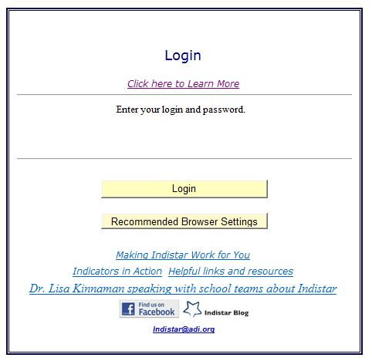
The Online System
Entry through a link on the SEA’s website

Slide 26




Masthead and Name
Each state has its own masthead and name for the system

Slide 27
Role and Privileges
Determined by Login and Password
  SEA Administration
  SEA Reviewers
  Coaches (External Partner, Internal Partner, as determined by LEA)
  Superintendent and LEA Process Manager
  Principal and School Process Manager
A Guest Login may also be provided, at the discretion of the LEA/School, to faculty, parents, partners, school board, etc. Read only privileges of key documents.

Slide 28
SEA Role and Privileges
SEA Administrative Site
LEAs and Districts
PDFs of Reports Submitted and Date
Access to Ongoing Work of School Teams
Data Mining Across Schools
May Not Amend School-Entered Data
SEA Reviewer Site
Access to School Reports
Entry of Reviewer Comments
May Not Amend School-Entered Data

Slide 29
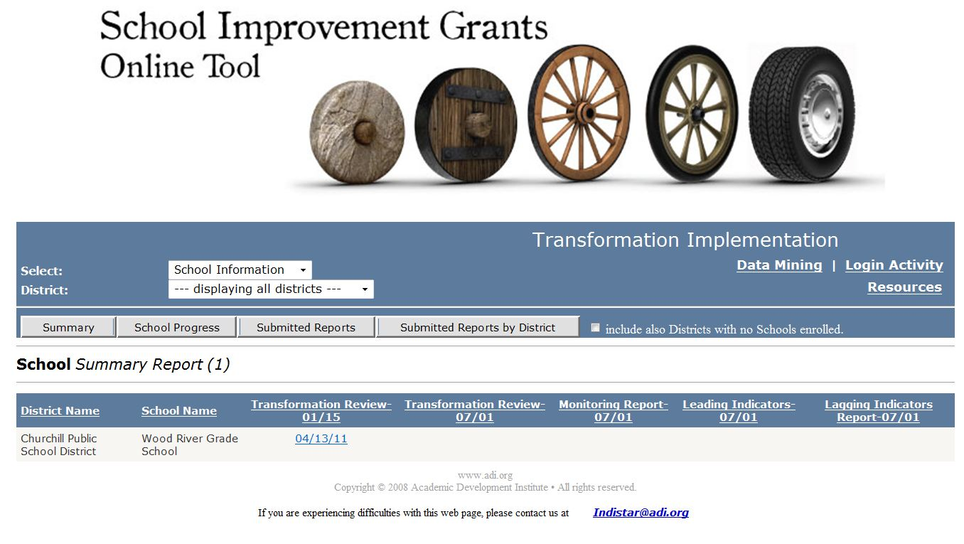
SEA Administrative Site
Masthead for example only: will display state-specific masthead and graphic

Slide 30
Coaching Role and Privileges
Privilege to Coaches Assigned to Schools
Coaching Dashboard with:
  Access to each school’s system for schools to which the coach is assigned
  Coaching Review feature with convenient access to progress information for each school
  Ability to enter Coaching Comments for each school; school may respond and dialogue
  May not amend school-entered data

Slide 31
LEA Roles and Privileges
Privilege to Superintendent, LEA Process Manager (designated by Superintendent)
LEA Dashboard with:
  Access to each school’s site
  Coaching Review feature with convenient access to progress information for each school
  Ability to enter Coaching Comments for each school; school may respond and dialogue
  May not amend school-entered data

Slide 32
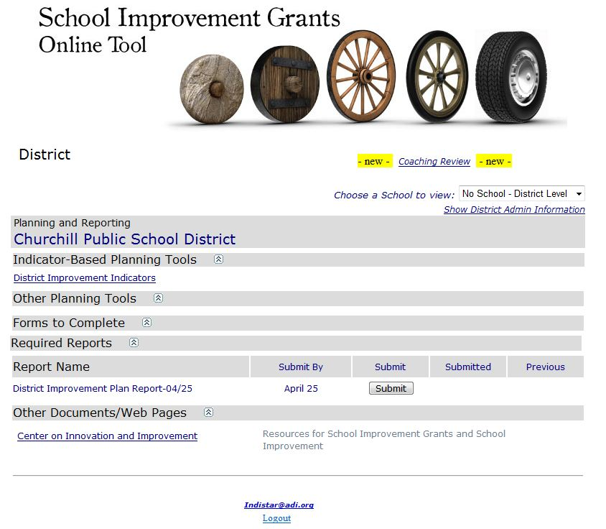
LEA Dashboard
Masthead for example only: will display state-specific masthead and graphic

Slide 33

School Role and Privileges
Privilege to Principal, School Process Manager (designated by Principal)
School Dashboard with:
  Access to school’s process, forms, report submissions, reports, resources
  Ability to respond to Coaching Comments and dialogue

Slide 34
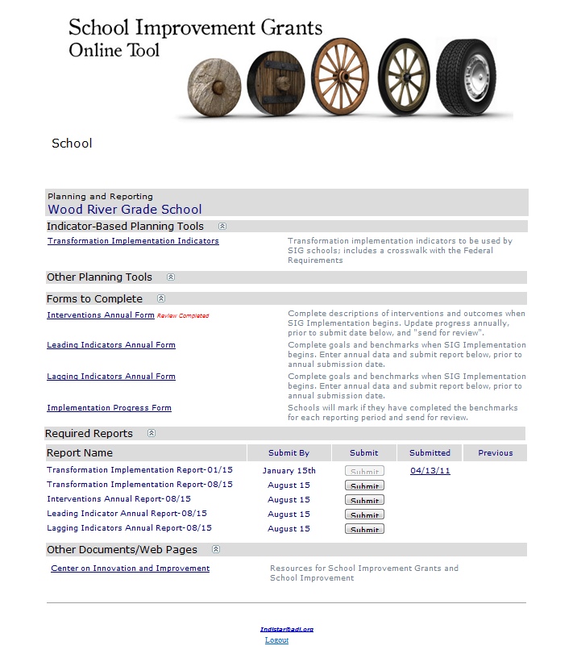
School Dashboard
Masthead for example only: Will display state-specific masthead and graphic

Slide 35
The School Process
Assess current status of each implementation indicator
Plans for full implementation of indicators not fully implemented
Monitors progress of task completion
Provides evidence of full implementation
School Transformation Team

Slide 36
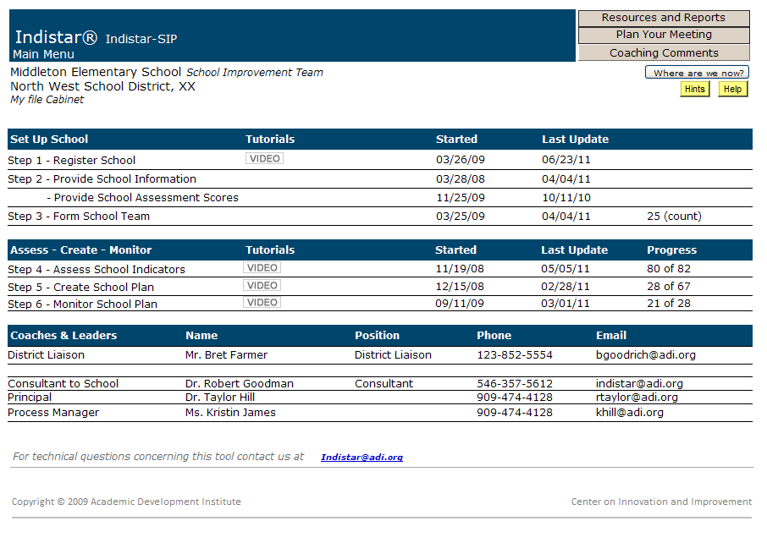
School Main Menu

Slide 37
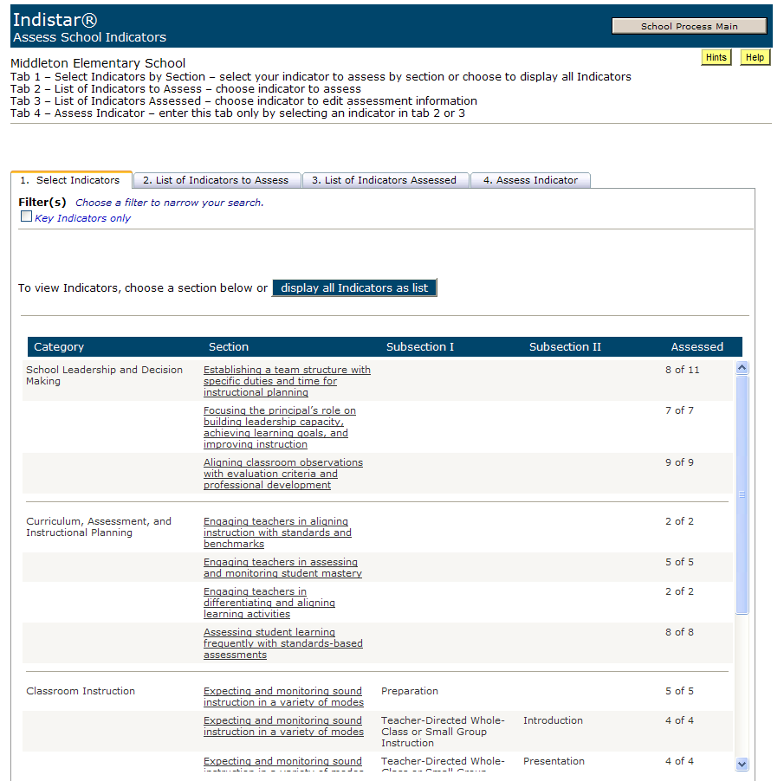
Assess Indicator

Slide 38
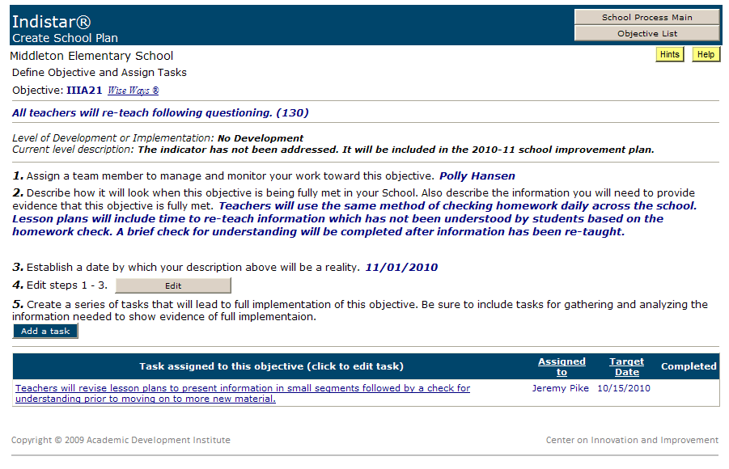
Plan for Full Implementation

Slide 39
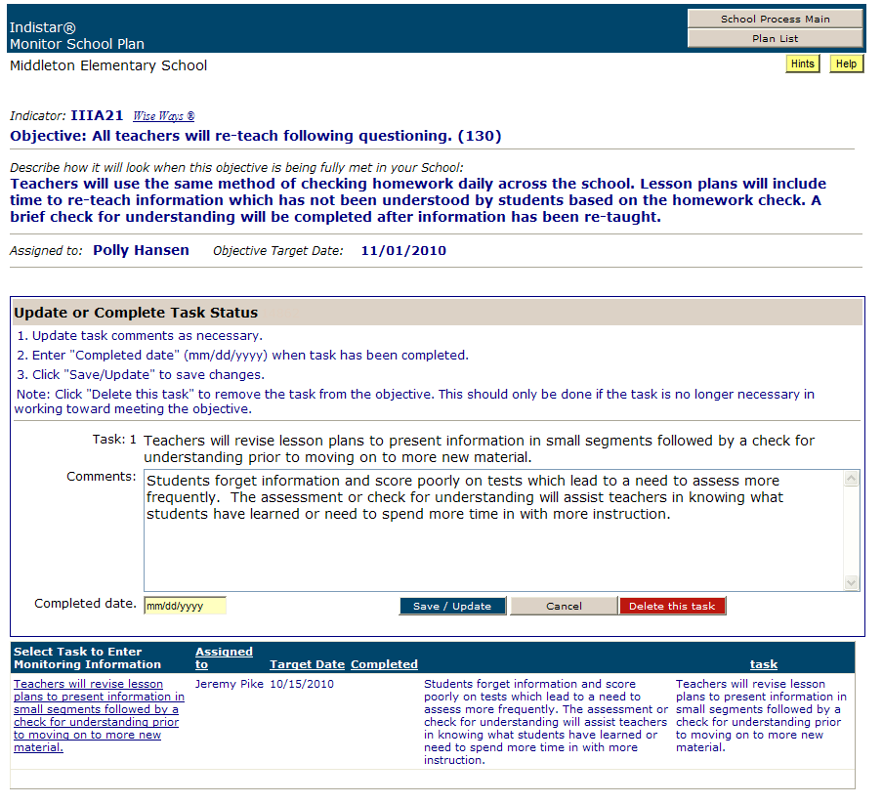
Monitor Progress

Slide 40
Agendas, Minutes, Worksheets
Prepared and downloaded from system by Process Manager
Emailed or copied and distributed to Team members

Slide 41
Reports
16 Reports in System
Downloadable in variety of formats
Automatically generated and up-to-date
Examples of Reports
Comprehensive Plan Report
Summary Report
Task Report
Indicator Checklist Report
Implementation and Monitoring Report
Detailed Report of Assessed Indicators
Coaching Comments Report

Slide 42
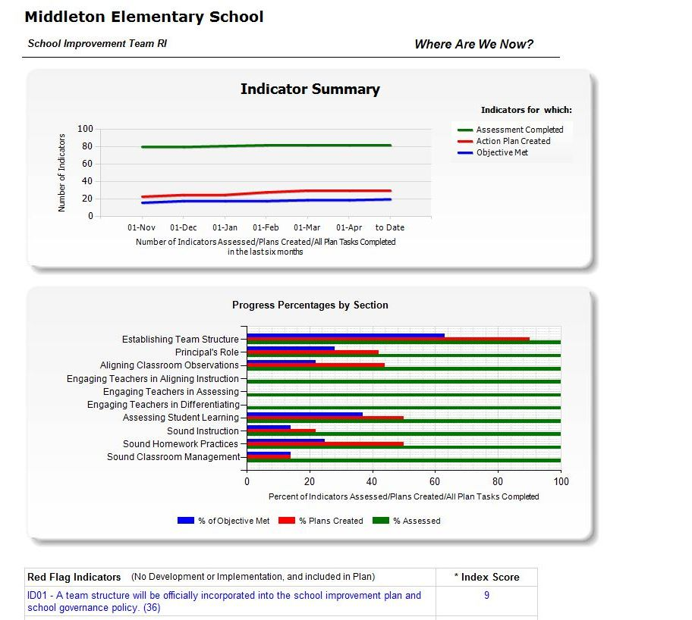
Where Are We Now?
Instant Graphic Display of Progress

Slide 43
Contact Information
Regional Comprehensive Center
Center on Innovation & Improvement
Sam Redding
sredding@centerii.org
217-732-6462 ext. 11

