Slide 1
School Improvement in the
Chicago Public Schools
A Focus on High School Change
Don Fraynd, Ph.D., Acting Officer
Chicago Public Schools Office of School Improvement
Randel Josserand, Director of School Development
Chicago Public Schools Office of School Improvement
Office of School Improvement Mission Statement
The Office of School Improvement will lead the transformation of the district’s lowest performing schools into high quality learning centers by: realizing and understanding past failures, maximizing internal capacity, developing and executing coordinated programmatic strategies, developing embedded relationships within the communities served, and establishing thought and funding partners within the nonprofit and corporate communities.

Slide 2
2,000 high schools produce half the nation’s dropouts
Number of High Schools Nationally by Different Levels of Promoting Power
(Class of 2006)
6,000
5,000
5,003
4,000
Number of High Schools
2,704
2,986
3,000
1,999
2,000
1,851
1,000
0
60% or below
61-70%
71-80%
81-89%
90% or above
Promoting Power
Special Thanks to Diplomas Now
Notes:
2

Slide 3
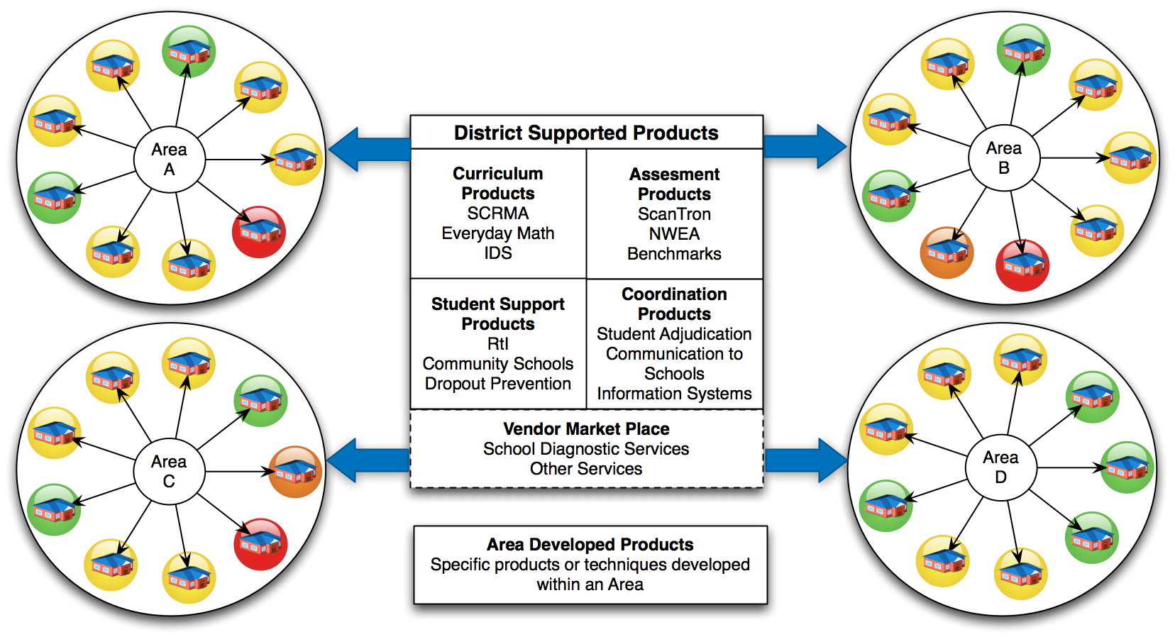
CPS has an Education Plan Differentiated by School Need
General Strategy = Strong, Independent, and Accountable Chief Area Officers
Office of School Innovation & Support
CAOs will select “interventions” and supports from the Office of Innovation & Support (and/or buy and create other supports) to assist school improvement, then be held accountable for results.
GREEN High Performance
YELLOW Medium Performance
ORANGE Medium – Low Performance
RED Low Performance

Slide 4
CPS has an Education Plan Differentiated by School Need
However, General Strategy is Not Sufficient for A Large Percentage of CPS High Schools
37 Tier I Schools
29 Tier II Schools
56
CPS has 66 of 95 Tier I & Tier II schools in Illinois – 70% of the worst performing schools in the state

Slide 5


CPS has an Education Plan Differentiated by School Need
Lowest Performing Schools are Managed by OSI for Intensive Intervention
Low Performing Schools are supported by the Office of School Improvement for intensive intervention, consolidation, or closure.
Office of School Improvement
GREEN High Performance
YELLOW Medium Performance
ORANGE Medium – Low Performance
RED Low Performance
Turnaround
Re-start
Continuing aggressive work at the elementary level is also critical to the overall strategy of improving high schools…
Transformation
Closure

Slide 6
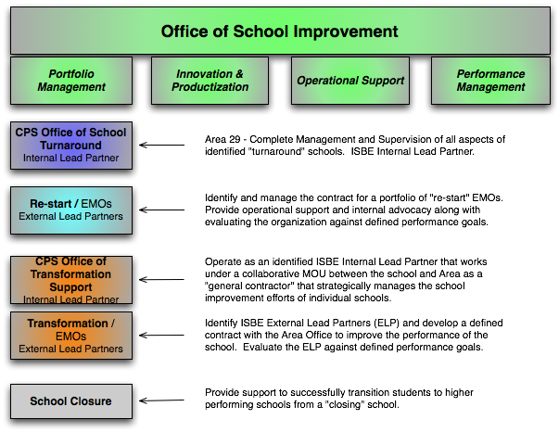
Managing the Four Federal Models for Improvement
A Portfolio of External and Internal Lead Partners

Slide 7
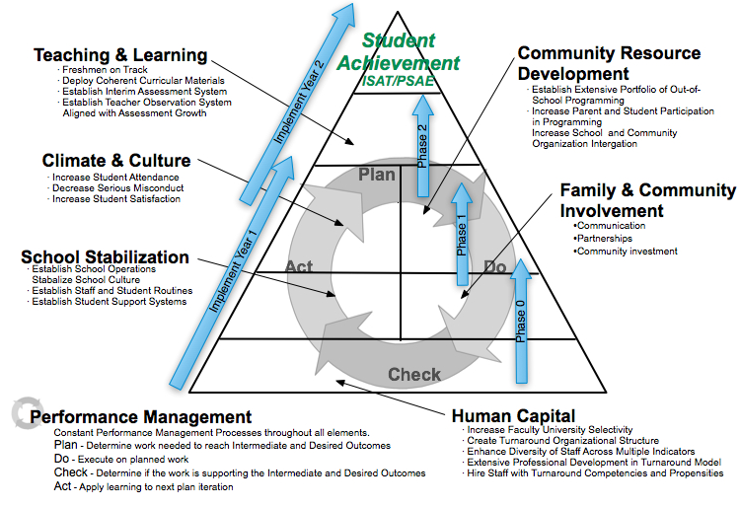
CPS Whole School Reform Model

Slide 8
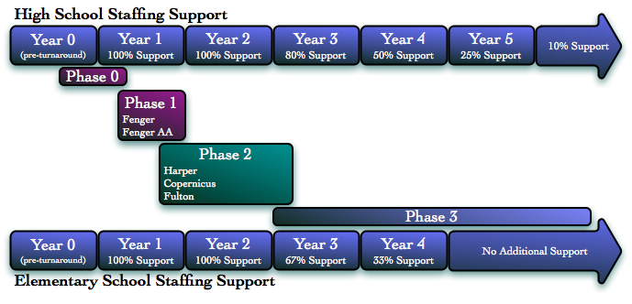
Learning from Past Reforms = TIME and SUSTAINABILITY
Organizational research tells us that it takes 4-6 years to bring lasting change to an organization
8
Notes:
8

Slide 9

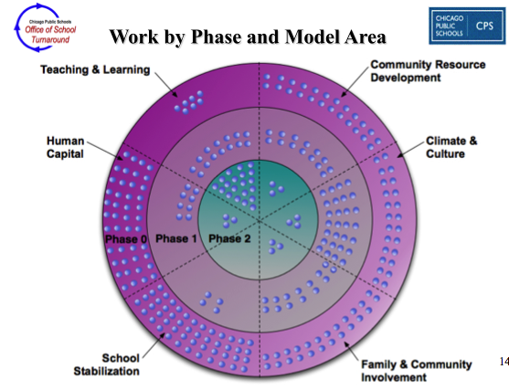
Learning from Past Reforms = TIME and SUSTAINABILITY
9
Notes:
9

Slide 10
CPS Office of School Improvement
“Human Capital Strategy”
The OSI Hiring Process - “Having the Right People on the Bus is Key”
Step 1
Resume
Review
Step 2
Phone
Interview
Step 3
Group
Interview
Step 4
Sample
Lesson
at School
Step 5
Student /
Community
Interview
Step 6
Reference
Checks
Job Embedded Professional Development – “Building Capacity for Sustainable Change”
Leadership Development Institute
Summer
Foundations
Institute
Weekly Professional Development
Sessions
Turnaround Interventionists
Coaching & Modeling
Performance
Management

Slide 11
Bringing Change to Scale

Slide 12
Contact Information
Don Fraynd, PhD
Turnaround Officer
Chicago Public Schools
Office of School Improvement
djfraynd@cps.k12.il.us
Randel Josserand
Director of School Development
Chicago Public Schools
Office of School Improvement
rbjosserand@cps.k12.il.us

