Slide 1



Supporting Rural Schools and Districts
Featuring:
Andrea Browning, American Youth Policy Forum
Bryan Setser, North Carolina Dept. of Education
Mark Bounds, South Carolina Dept. of Education

Slide 2
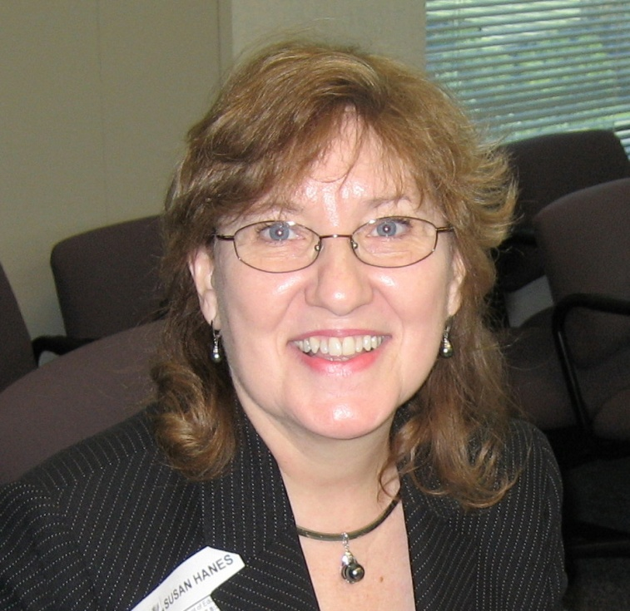
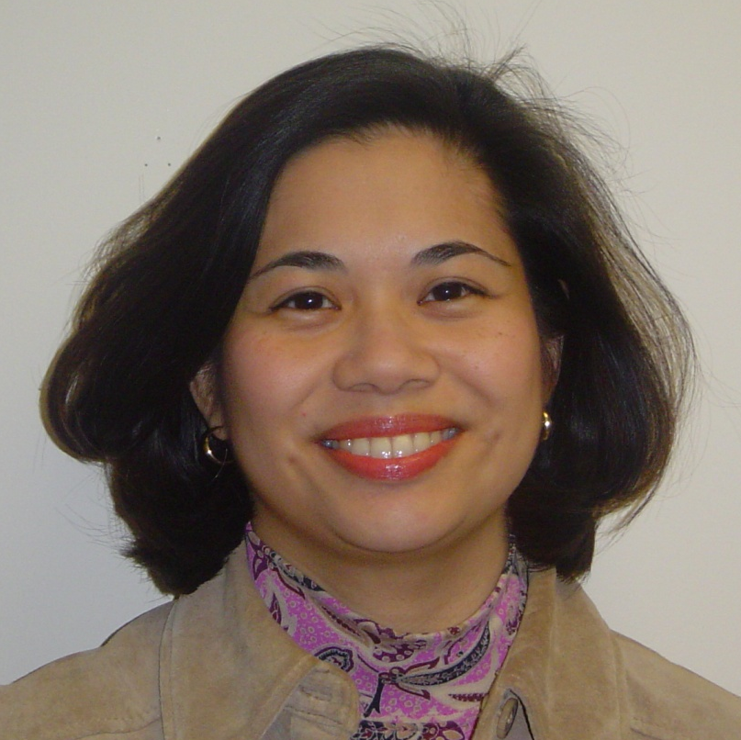
NNSSIL Co-coordinators
Susan Hanes
Technical Advisor, Center on Innovation and Improvement
Nina de las Alas
Senior Program Associate, Council of Chief State School Officers
Notes:
2

Slide 3
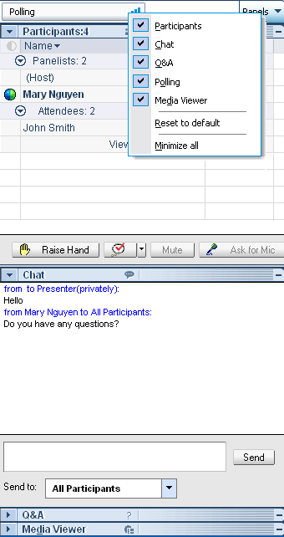
WebEx Panels & Features
Participants
Raise/lower hand
Chat
Q&A
Notes:
3

Slide 4
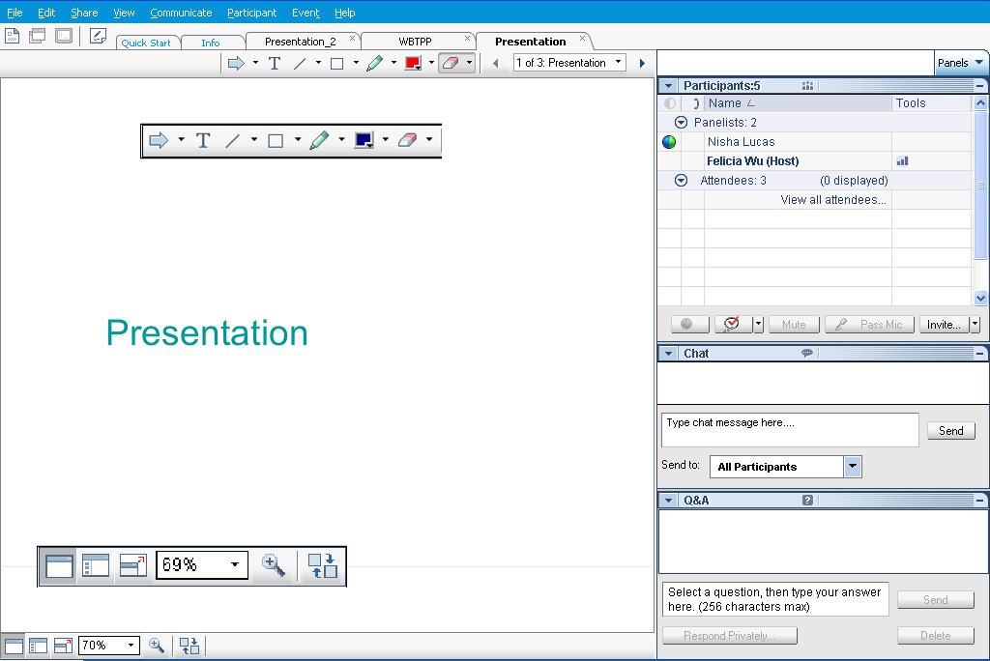
Webex Panels & Features
Presentations
Visual magnification
Audio volume (manual control through your phone or if using VOIP through computer’s audio controls . If you still cannot hear, please send Nina a chat message) or contact WebEx Tech Support (866-229-3239).
Notes:
4

Slide 5
National Network of State School Improvement Leaders (NNSSIL)
Vision
Network of state leaders engaged in developing an evidence-based body of knowledge that can lead to accelerating sustainable school, district and state improvement to raise educational results for all learners.
Mission
To provide collegial support among state leaders of school improvement to build, utilize and disseminate a robust body of knowledge of professional practices leading to systemic educational change.

Slide 6
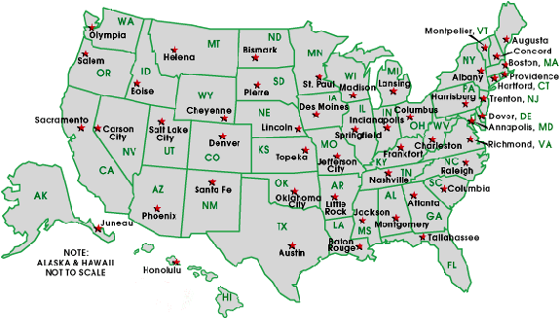
National Network of State School Improvement Leaders (NNSSIL)
Membership
50+ SEAs and territories
16 Regional Comprehensive
Centers (RCCs) & 5 Content
Centers
Advisory Group – Design Team
Subgroup of state reps., sub-dir.-level RCC
staffers, US ED, and NNSSIL co-coordinators
Administrative Partners
Center on Innovation & Improvement
Council of Chief State School Officers
More information: http://www.centerii.org/leaders

Slide 7
Supporting Rural Schools and Districts
Purpose
Provide an overview of schools and districts in rural settings, highlighting
  What it means to be a “rural” school or district
  Key issues in policy and practice for rural schools
  Federal funding for rural schools
Present two states’ approaches to providing quality education to rural schools and districts: North Carolina & South Carolina
Field questions from participants

Slide 8
Featured Presenters

Slide 9
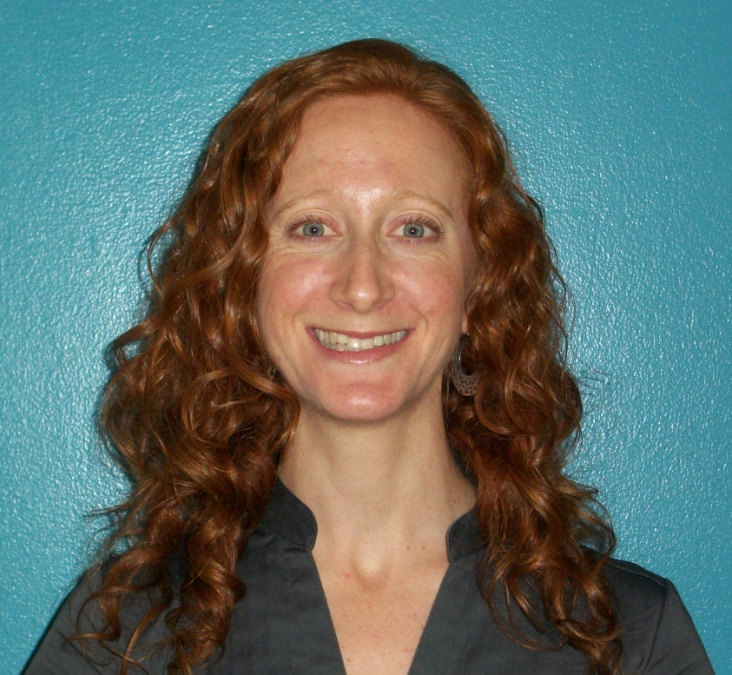
Featured Presenters
Andrea Browning
Program Associate
American Youth Policy Forum

Slide 10
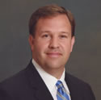
Featured Presenters
Bryan Setser
Chief Executive Officer
North Carolina Virtual Public School

Slide 11
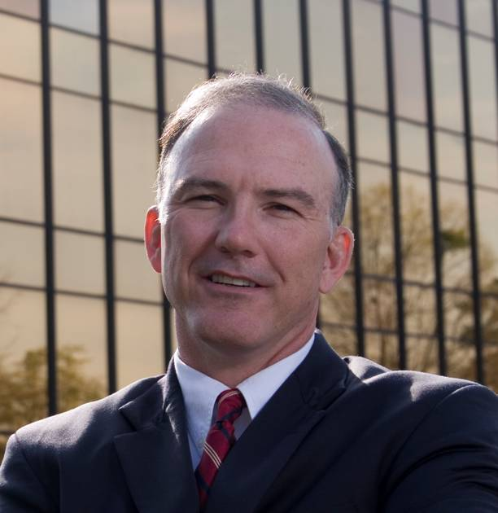
Featured Presenters
Mark Bounds
Deputy Superintendent
South Carolina Office of Educator Quality and Leadership

Slide 12
Q & A and Discussion

Slide 13
Q & A and Discussion
Please note that your phone line is muted upon entry and will remain muted (see red x in front of your name)
To get speakers’ attention, please use the “Raise Hand” button in the Participants Panel. We will un-mute then.
You can also post your questions or comments on the Q & A Panel.
Notes:
13

Slide 14
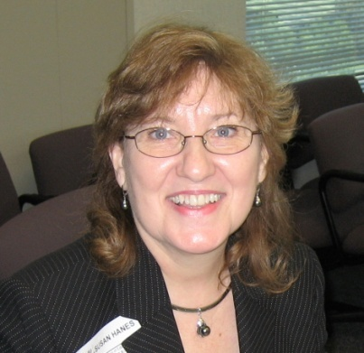

Panelists
Susan Hanes
NNSSIL Co-Coordinator/
Moderator
Andrea Browning
AYPF
Bryan Setser
North Carolina DOE
Mark Bounds
South Carolina DOE
Notes:
14

Slide 15
For More Information www.centerii.org/leaders
Link to this webinar’s recording, slides and resources mentioned during the presentations
NNSSIL Community Site
School Improvement Grants Resources
LEA SIG Survey – http://www.centerii.org/CenterIIPublic/SIG_Survey.aspx
Feedback
Follow-up questions? Send to Susan Hanes, shanes@centerii.org

Slide 16

Thank you to our featured presenters and thank you all for participating in today’s webinar!
Notes:
16

