Slide 1
Idaho Statewide System of Support (SSOS)
NNSSIL Webinar – Addressing the Needs of All Students through School Improvement
September 12, 2012
Steve Underwood
Director of the Statewide System of Support
Notes:
Objective:
This webinar examines how states and districts orchestrate and coordinate various policies, practices and intervention strategies to meet the needs of all students. In Idaho, we do this in many ways, and we are still learning and growing. Our state has grown through a process of ongoing self-reflection in order to improve our system. Presently, rather than trying to leverage separate programs that are good on their own, but confusing when put together, we are now focusing on developing a cross-program strategy in which programs are complementary and work as a systemic whole to target and support districts and schools according to their specific needs. In the next few minutes, I’ll share how my team is doing this by being a learning organization that is committed to a common theory of action that we use to evaluate how well we’re actually impacting LEAs and schools to be able to meet the needs of all learners.

Slide 2
SSOS – Round One (Prior to 2009)
ESEA School Improvement
School Support Teams
Distinguished Educators
School Improvement Planning to Meet AYP
School support offerings
Idaho Building Capacity
Principals Academy of Leadership
Reading First
Focus on Improvement, Corrective Action, and Restructuring
Notes:
When we started down the road of developing a Statewide System of Support, it was in response to Title I findings (2005, 2008). The focus was meeting the needs of Title I schools in improvement status.
We started with what was under our control…compliance and school improvement funding.

Slide 3
SSOS – Round Two (2009 - early 2011)
ESEA School Improvement
School Support Teams
Distinguished Educators
Schoolwide Title I
Other State Initiatives
Making Meaningful Connections
Notes:
As we worked through our school improvement programs, we kept running up against all the other initiatives and things in the state that were connected to school improvement, but which were operating out there on their own with little to no intentional connection. Therefore, we started creating documents and providing connections to those programs, initiatives, and resources … but we were still limited to Title I schools in improvement.

Slide 4
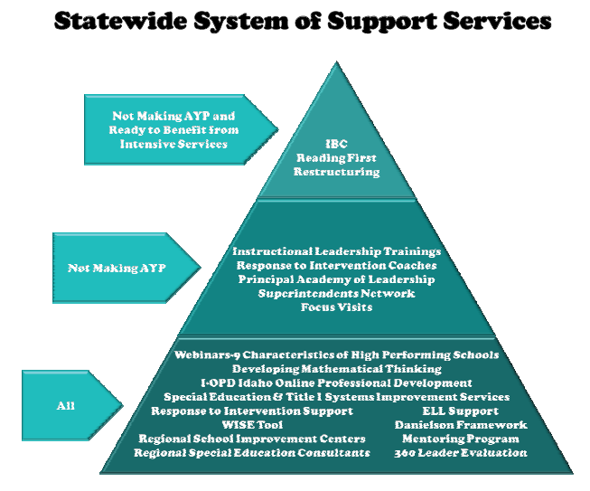
Former Perspective: Intensity & Availability of Services
Our thinking in Fall 2009
Notes:
At the beginning, we focused on the development of good programs and began to think in terms of the RTI perspective of intensity. However, while we were focused on the intensity and availability of the program…many LEAs and schools were not eligible for the program or were left out for various reasons. This completely goes against the RTI perspective because in RTI, you provide the appropriate support service to the student based on their level of intensity/level of need, not based on what you have available. If you don’t have the right support available for the student’s need, you create it. This has been a shift in our thinking that we’re still working on, but getting better at. We’ve since shifted to looking at the intensity of what LEAs and schools need to try to deliver the right kinds of supports.

Slide 5
New Perspective: Intensity and Differentiation of LEA or School Need
Most in Need of Support
In Need of Some Support
Least Intensive Need
Notes:
Now, with the ESEA Waiver, we are “exploiting policy” to move toward where we’ve wanted to go.
Differentiation of support based on a spectrum of performance
Integration of supports that match the needs.
For example, we have designed a plan in which the most intensive LEAs/Schools will be given a diagnostic review (a Focus Visit based on CII’s Patterns of Practice) to determine what’s needed.
Then, we plan to broker the resources necessary to help make it happen.
This will include participation in existing programs, but also efforts to customize the delivery of other supports.

Slide 6
One Student … Many Programs
What is the experience for the student? Are schools and LEAs able to be coherent if the SEA isn’t?
RTI
Etc.
After School
Title I
Title I
After School
RTI
Etc.
Notes:
As we think about differentiating among LEAs and schools, we keep in mind the experience of one student. That student might be in Title I, RTI, after school programs, LEP, SPED, etc. In other words, we may be trying to impact one child through many different programs that should be connected, but are often times disjointed. Thus, how are we helping schools and districts ensure that the programs we are helping put into place are done so in a coherent manner from the perspective of a child receiving the various program services.

Slide 7
SSOS – Round Three (2011 – Present)
Statewide System of Support
Family & Community Engagement
Response to Intervention
Systems Improvement
21st Community Learning Centers
GEAR UP
Educator Effectiveness (Evaluation)
Traditional ESEA SSOS Focus
School Turnaround (SIG and Waiver Plan)
Multiple programs and strategies that focus on rethinking the system of how to serve all students:
College readiness in secondary schools
Communities & Families
School Effectiveness
Notes:
We have been slowly re-organizing over time to place various programs all under the oversight of the SSOS. We began with the traditional ESEA focus on SSOS (i.e., school improvement, corrective action, and restructuring). That expanded to include the concept of school turnaround in SIG and now the waiver, but not at the expense of the larger mission of the SSOS.
Other programs that deal with systemic improvement also fall with the SSOS now. (describe how each fits)
Our goal is to be a whole that is greater than the sum of its parts. To do this, we have a common theory of action and are focusing on continuous support of one another. We ask ourselves: “What is it that we want to continue even if federal or state program funding goes away?” AND “How can we leverage each other to make sure that happens.
For example:
GEAR UP – strengths in middle school and secondary school … building social capital in students to prepare for college (We are working to connect GEAR UP strengths to the secondary indicators in Indistar and vice versa finding ways to support GEAR UP sites through improvement planning.)
21st CCLC – strengths in family and community engagement (We are working to connect 21st CCLC strengths with FACE indicators in Indistar and vice versa finding ways to support 21st CCLC sites through improvement planning connections to the school day.)
Educator Effectiveness – strength in utilizing evaluation as a professional development process that is job embedded, etc. (We crosswalk Danielson with improvement plans and use improvement plans to support Danielson.)
IBC – We train the coaches in the various other programs on an as needed basis to help them build capacity for systemness in LEAs and schools.

Slide 8
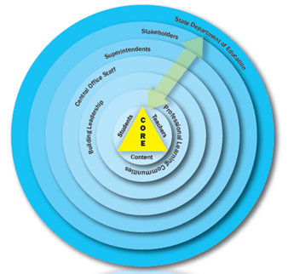
The Logic Model Behind Our Theory of Action
Core Components
Outcomes
Impacts
Develop Coherence Across the System
Examples:
Integrated Focus Visits
Cross-program planning
Evidence of the Increased Presence of the Characteristics of Effective Schools
Clear and shared focus
High standards and expectations for all students
Effective school leadership
High levels of collaboration and communication
Curriculum, instruction, and assessment aligned with standards
Frequent monitoring of learning and teaching
Focused professional development
Supportive learning environment
High levels of family and community engagement
Successful Students
All students (including those who have traditionally been underserved) are on track in relation to college and career readiness
Differentiate Supports Based on Intensity of Need
Examples:
Accountability requirements based on performance
Differentiated monitoring
Prioritize grants and services
Systemic and Sustained Improvement Infrastructure
State and local policies, processes, and practices sustain the continuous improvement of the instructional core by focusing on coherence, differentiated support, group quality, and capacity building at each level of the Mega-System.
Capitalize on Professional (Social) Networking
Examples:
Learning communities
Training opportunities targeting teams
Build Leadership Capacity
Examples:
Coaching leaders and teams
Technical assistance and training opportunities
Notes:
To move forward, we have a common theory of action. It is a step removed from a “program” theory of action. Rather, it’s focused more on the overarching strategies that we have learned we need to use within and between programs. We focus on:
Developing coherence
Differentiating supports
Capitalizing on professional networking
Building Capacity
The goal of these strategies is to impact the appropriate layer of the Mega System to develop an improvement infrastructure that is focused on the Nine Characteristics of High Performing Schools…since these cover all of our programs’ goals.
With this theory of action, we plan to spend the next 5 years in partnership with the REL-NW evaluating the degree to which we’re adhering to these four core components as well as the degree to which they are impacting the outcomes and impacts that we intend.
We’re trying to be a true learning organization:
We are committed to not forgetting the lessons of the past (successes and failures)
We are working to maintain a focus on self-evaluation for continuous improvement
We subjugate compliance to effectiveness

Slide 9
SSOS/REL Alliance
Goal of the Research Alliance is to ultimately:
Continuously improve the design and implementation of the Idaho SSOS
Notes:
We’re trying to be a true learning organization:
We are committed to not forgetting the lessons of the past (successes and failures)
We are working to maintain a focus on self-evaluation for continuous improvement
We are committed to effectiveness of practice; while we will be compliant with laws and regulations, we will also subjugate compliance to effectiveness and find ways to exploit policy to support our theory of action.
This entails continuous collaboration through weekly meetings of the programs in the SSOS and monthly to quarterly collaboration/planning/evaluation meetings with representatives from other ESEA programs, SPED, Teacher Certification, and Curriculum and Assessment.
With the theory of action to which we’ve agreed, we plan to spend the next 5 years in partnership with the REL-NW evaluating the degree to which we’re adhering to these four core components as well as the degree to which they are impacting the outcomes and impacts that we intend. This is the first year of the research alliance and we’ll be focused on two prongs of research: 1) an in-depth evaluation of one program and 2) an implementation study in relation to the coherence between programs.
For the latter, we expect to find some initial changes that have occurred since 2011, especially related to the programs that have been re-organized and clustered under the SSOS umbrella. For example, the 21st CCLC Program is included in the ESEA Waiver to encourage extended learning time. Prior to August 2011, our 21st program had not been included in school improvement efforts at all. The school improvement team hardly knew about them and vice versa. Now, they are not only aware of each other’s work, but overlapping types of support have begun to occur. The 21st program has identified itself with specific indicators within Indistar and has used those to provide training to its participants. The program directors in participating sites have expressed that they often felt disconnected from the school day, but they are now looking for ways to become connected with the local school improvement teams.
Another example of how some of this cross-over work is growing is with the GEAR UP program’s relationship to school improvement. Similar to 21st programs, they were never included in the conversation prior to 2011. However, they have great expertise in helping impact the thinking of middle school and high school staff about college readiness for at-risk students. While their project is focused on participating schools/LEAs, we are leveraging their knowledge in school improvement planning. We just added CII’s secondary indicators for both our middle and high schools. Then, we will be making all of the resources developed by and used in GEAR UP available for free to the rest of the state. They won’t have the benefit of the program, but they can benefit from the thinking behind the program as they work on overall improvement strategies.
These are some of the things that have occurred already. The evaluation of our work will bring out some strengths, but we know it will bring out weaknesses too. Those are the areas that we’ll choose to work on for next steps.

Slide 10
Questions?
Steve Underwood
Director of the Statewide System of Support
Email: sunderwood@sde.idaho.gov
Phone: 208-332-6922

