Slide 1



Addressing the Needs of All Students through School Improvement
Sherry Thomas, North Carolina Department of Public Instruction
George Hancock, North Carolina Department of Public Instruction
Steve Underwood, Idaho Department of Education

Slide 2
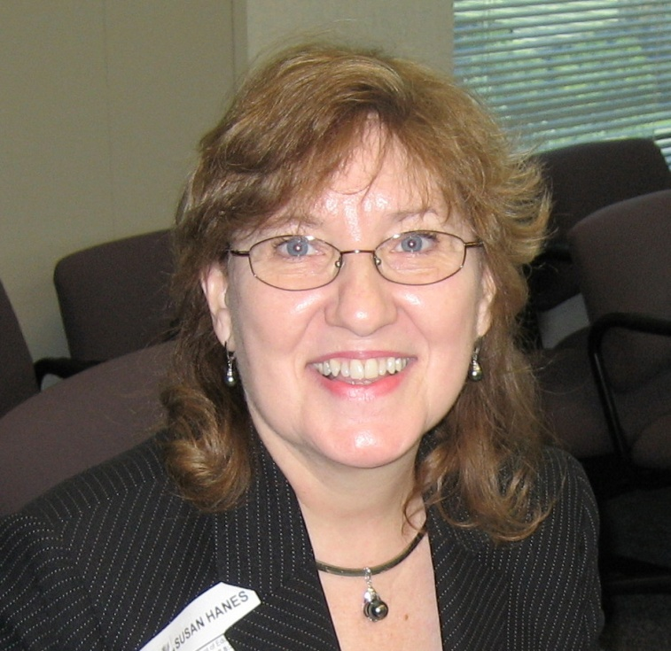
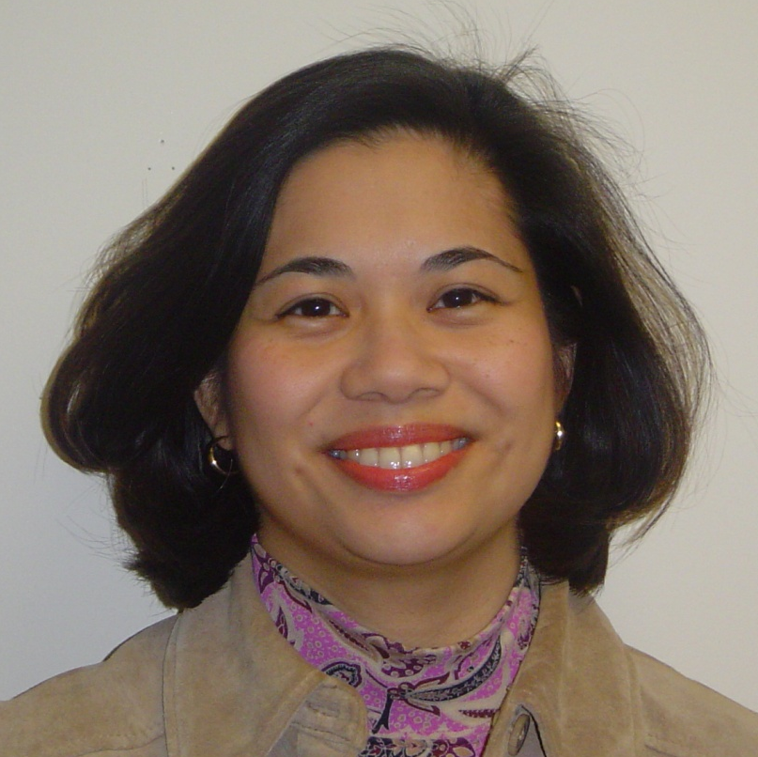
NNSSIL Co-coordinators
Susan Hanes
Technical Advisor, Center on Innovation and Improvement
Nina de las Alas
Program Director, Council of Chief State School Officers
Notes:
2

Slide 3
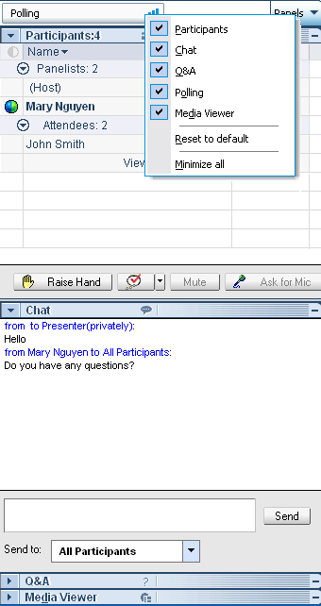
WebEx Panels & Features
Participants
Raise/lower hand
Chat
Q&A
Notes:
3

Slide 4
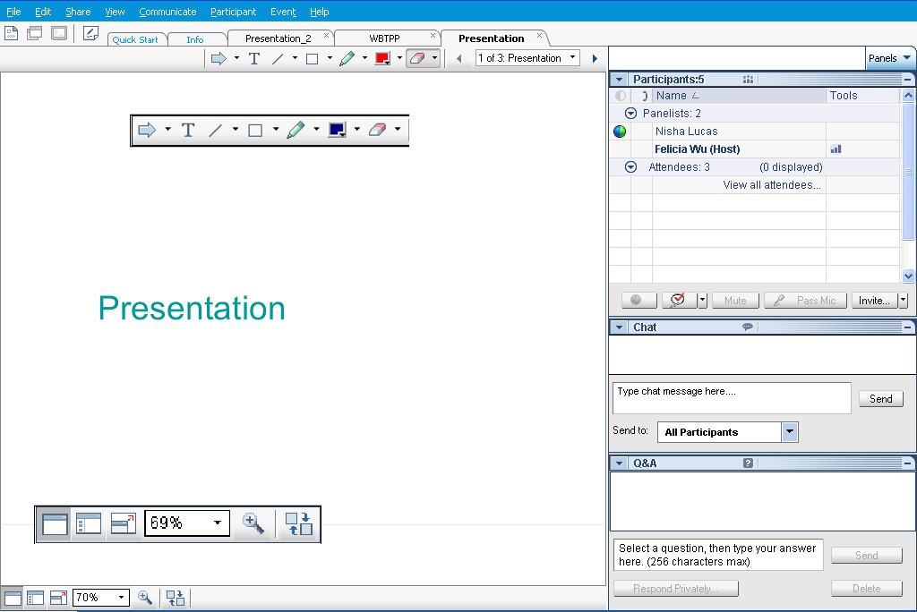
Webex Panels & Features
Presentations
Visual magnification
Audio volume (manual control through your phone or if using VOIP through computer’s audio controls . If you still cannot hear, please send Nina a chat message) or contact WebEx Tech Support (866-229-3239).
Notes:
4

Slide 5
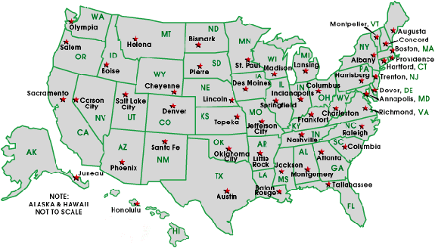
National Network of State School Improvement Leaders (NNSSIL)
Membership
50+ SEAs and territories
16 Regional Comprehensive
Centers (RCCs) & 5 Content
Centers
Advisory Group – Design Team
Subgroup of state reps., sub-dir.-level RCC
staffers, US ED, and NNSSIL co-coordinators
Administrative Partners
Center on Innovation & Improvement
Council of Chief State School Officers
More information: http://www.centerii.org/leaders

Slide 6
Addressing the Needs of All Students through School Improvement
Purpose
Present perspectives from North Carolina and Idaho
Describe the evolution of their respective statewide systems of support
Identify how the respective SEAs orchestrate and integrate various state and federal programs, policies, practices and intervention strategies that address different student groups to meet the needs of all students
Share how the Idaho and North Carolina are determining progress for its own agency as well as for districts, schools and students
Highlight successes, ongoing issues, challenges, and points to consider
Field questions from participants

Slide 7
Featured Presenters

Slide 8
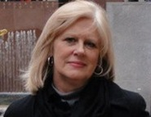
Featured Presenters
Sherry Thomas
Section Chief
Exceptional Children Division
North Carolina Department of
Public Instruction

Slide 9
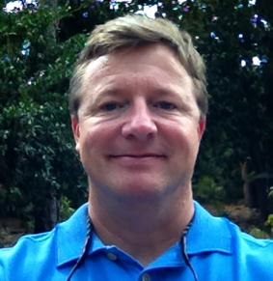
Featured Presenters
George Hancock
SIG Coordinator
North Carolina Department of
Public Instruction

Slide 10
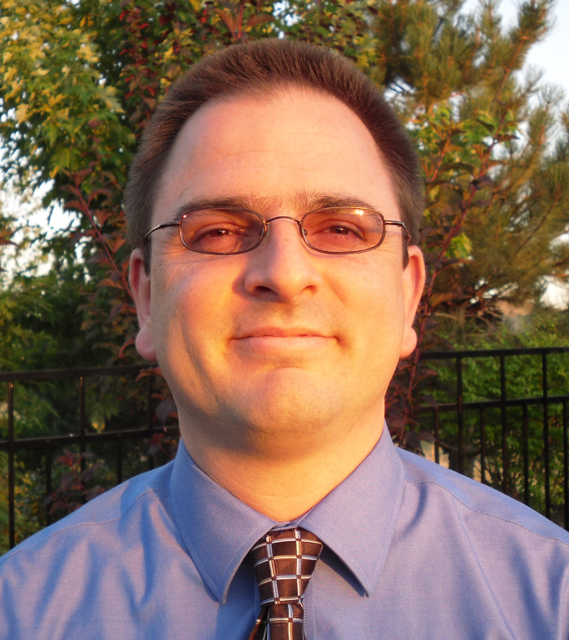
Featured Presenters
Steve Underwood
Director of Statewide Systems of Support
Idaho Department of Education

Slide 11
Q & A and Discussion

Slide 12
Q & A and Discussion
Please note that your phone line is muted upon entry and will remain muted (see red x in front of your name)
To get speakers’ attention, please use the “Raise Hand” button in the Participants Panel. We will un-mute then.
You can also post your questions or comments on the Q & A Panel.
Notes:
12

Slide 13

Panelists
Susan Hanes
Moderator
Steve Underwood
Idaho DOE
George Hancock
North Carolina DPI
Sherry Thomas
North Carolina DPI
Notes:
13

Slide 14
For More Information www.centerii.org/leaders
Link to this webinar’s recording, slides and resources mentioned during the presentations
Feedback
Follow-up questions? Send to Nina de las Alas, ninaa@ccsso.org

Slide 15

Thank you to our featured presenters and thank you all for participating in today’s webinar!
Notes:
15

