Slide 1
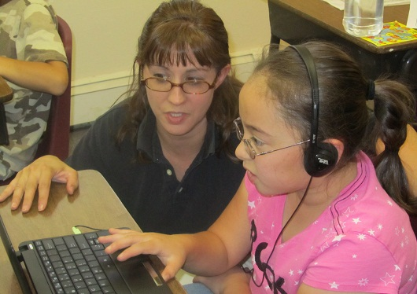
A Community-Driven, Blended Learning Approach to K-12 Education

Slide 2
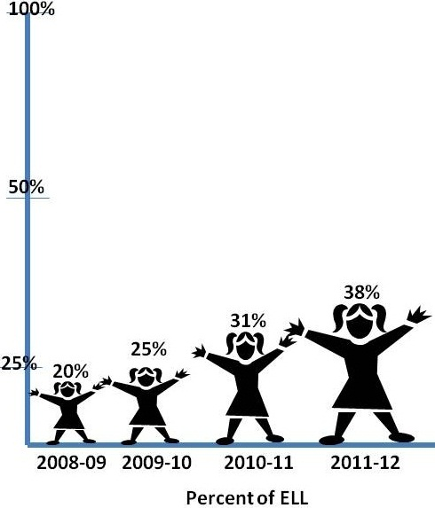
Students Served
Level | Eng. Spkg | NEP | LEP | FEP | Total Level
Ele | 870 | 320 | 260 | 57 | 1507
 | 57.7% | 21.2% | 17.3% | 3.8% | 100.0%
MS | 471 | 101 | 157 | 64 | 793
 | 59.4% | 12.7% | 19.8% | 8.1% | 100.0%
HS | 522 | 25 | 86 | 17 | 650
 | 80.3% | 3.8% | 13.2% | 2.6% | 100.0%
Total | 1863 | 446 | 503 | 138 | 2950
 | 63.2% | 15.1% | 17.1% | 4.7% | 100.0%

Slide 3
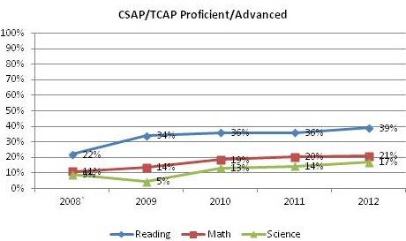
Current Achievement
 |  |  |  |  | 2012 TCAP Reading % Prof/Adv
 | Non English Proficient |  |  |  |  | Limited English Proficient |  |  |  |  | Fully English Proficient
Grade | State | HOPE | DIFF |  | Grade | State | HOPE | DIFF |  | Grade | State | HOPE | DIFF
3 | 11 | 7 | -4 |  | 3 | 53 | 57 | 4 |  | 3 | 93 | 100 | 7
4 | 4 | 11 | 7 |  | 4 | 35 | 33 | -2 |  | 4 | 87 | 85 | -2
5 | 6 | 7 | 1 |  | 5 | 29 | 37 | 8 |  | 5 | 86 | 90 | 4
6 | 8 | 27 | 19 |  | 6 | 26 | 37 | 11 |  | 6 | 83 | 90 | 7
7 | 5 | 4 | -1 |  | 7 | 17 | 34 | 17 |  | 7 | 71 | 78 | 7
8 | 3 | 4 | 1 |  | 8 | 12 | 20 | 8 |  | 8 | 63 | 75 | 12
9 | 3 | 11 | 8 |  | 9 | 14 | 30 | 16 |  | 9 | 64 | 75 | 11
10 | 2 | 14 | 12 |  | 10 | 16 | 22 | 6 |  | 10 | 67 | 100 | 33
73%
2012 State grd. 3-10 median

Slide 4
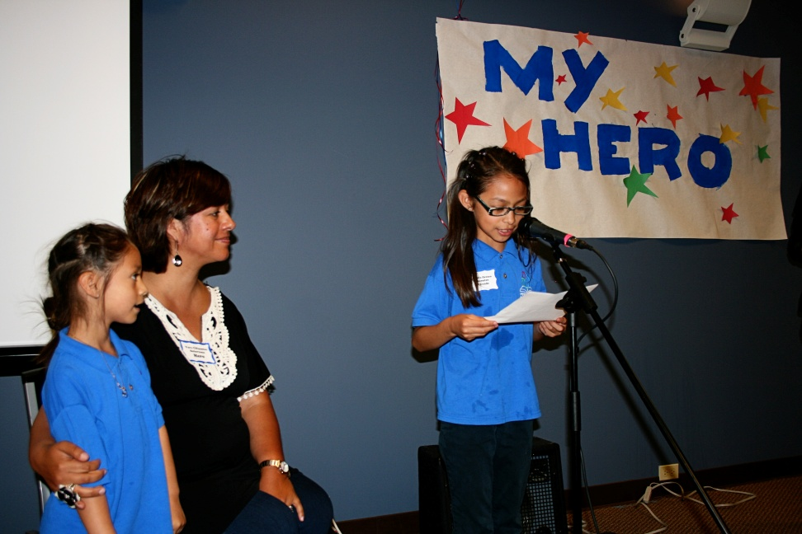
Identifying ELLs
2011-12 ELL enrollment by level and proficiency
STATE
Home language survey
CELA Placement
(W-APT starting in 2012-13)
Parent notification
Language plan
Body of Evidence
CELA Proficiency
(ACCESS starting in 2012-13)
HOPE
State +
Early reading screener
Interim benchmark reading and math
Language Look Fors
WIDA formative assessments

Slide 5
Monitoring Progress of ELLs
2011-12 ELL enrollment by level and proficiency
STATE
CELA Proficiency Status
(ACCESS starting in 2012-13)
CELA pro Growth Percentile
HOPE
CELA Proficiency Status and changes each year
Early reading screener
Interim benchmark reading and math
Reading/Math Learning Target Look Fors checklist
Monthly progress probes
Quarterly WOW Vocabulary Assessments
Language Look Fors
WIDA formative assessments

Slide 6
Formative Measures
Monthly Probes
Based on reading and math learning targets
Provides a progress measure of understanding and application of concept
Creates a portfolio for a cross-year look at student reading, writing, and language use
Informs instructional groupings

Slide 7
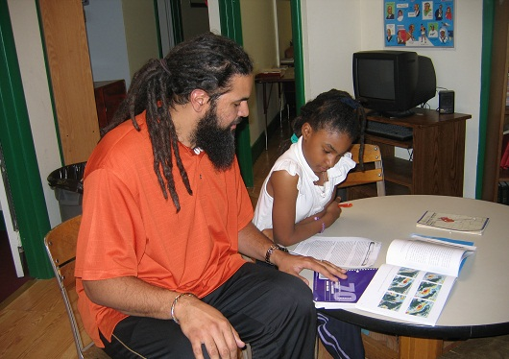
Program Innovations
Immersion approach
Community-based Learning Centers
ELA endorsed educators and ELL Teacher Specialists to provide ongoing embedded PD
Computer-based programming to support language learning
Individualized and group instruction
Authentic project-based learning
Partnership with higher education

Slide 8
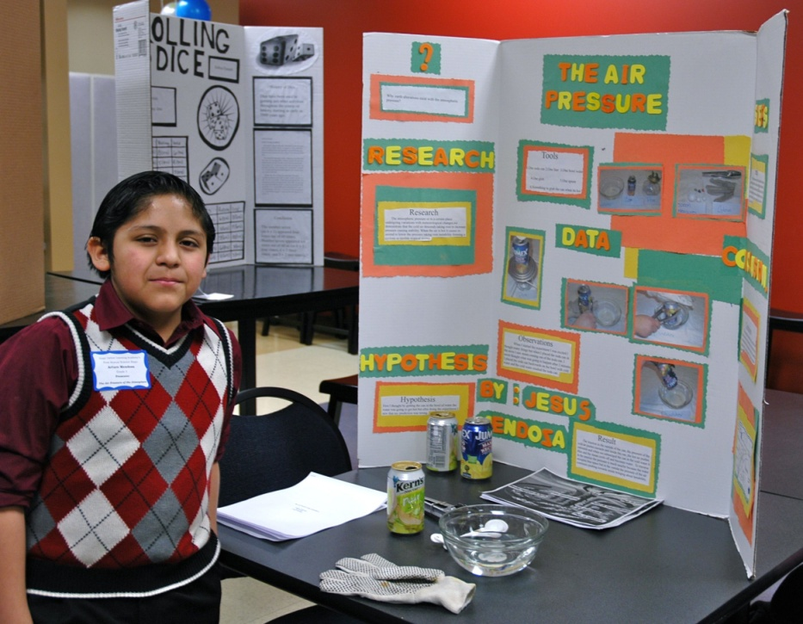
Janet Filbin, Ph.D. Director of Student Achievement HOPE Online Learning Academy janet.filbin@hopeonline.org 720-402-3026
Web address: http://www.hopeonline.org/
Notes:
For more information about HOPE and for access to the documents shown today please visit our websiite at hopeonline.org or email janet.filbin@hopeonline.org.

