Slide 1
Mechanisms for Determining Progress and Grant Renewals National Network of State School Improvement Leaders Presentation April 18, 2012
Kim Benton, Office of School Recovery
Mississippi Department of Education

Slide 2
Mississippi
14
Transformation
3 - Elementary
2 - Middle
8 - High Schools
1 - Attendance Center
4
Turnaround
2 - Elementary
1 - Middle
1 - High School
18 Schools

Slide 3
Gauging SIG Progress in Mississippi
Technical Assistance Visits and Monthly Reports by OSR Staff
SIG Mississippi Star (Indistar) Reporting by Districts
Pilot in November 2011-June 2012
Annual Monitoring Visit (Programmatic and Fiscal)
Interviews, Observations, Supporting Documentation
Quarterly Reports
ARRA Financial Reports and Implementation Specialists’ Summaries
Grant Renewal
Notes:
An Integrated Approach
Regulatory Function / Compliance
+
Emphasis on Effectiveness of Implementation
+
Targeted Technical Assistance
=
SIGnificant School Improvement

Slide 4
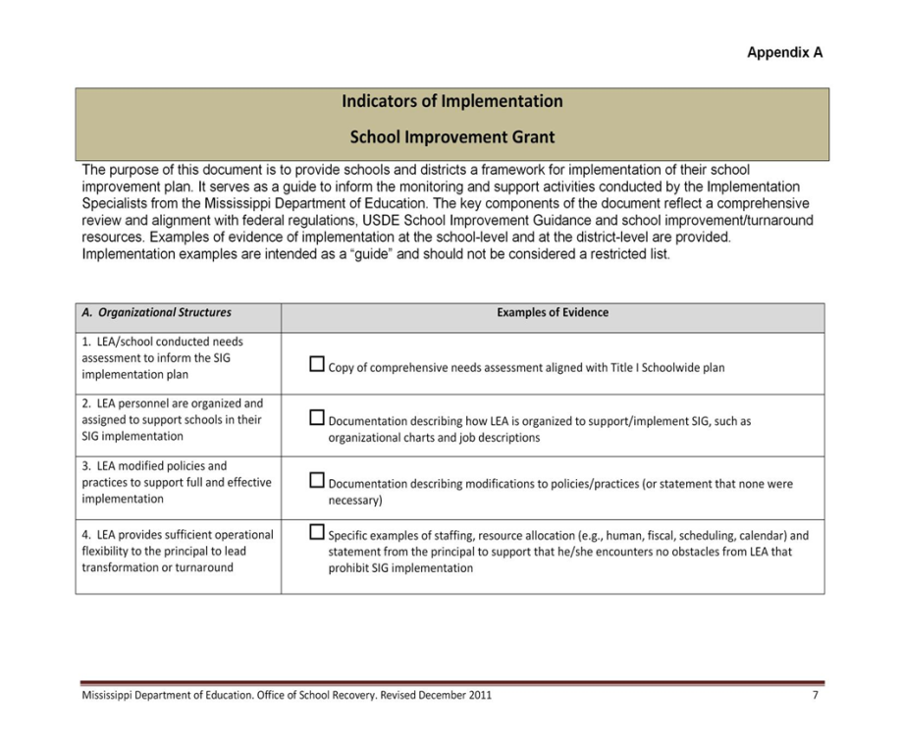
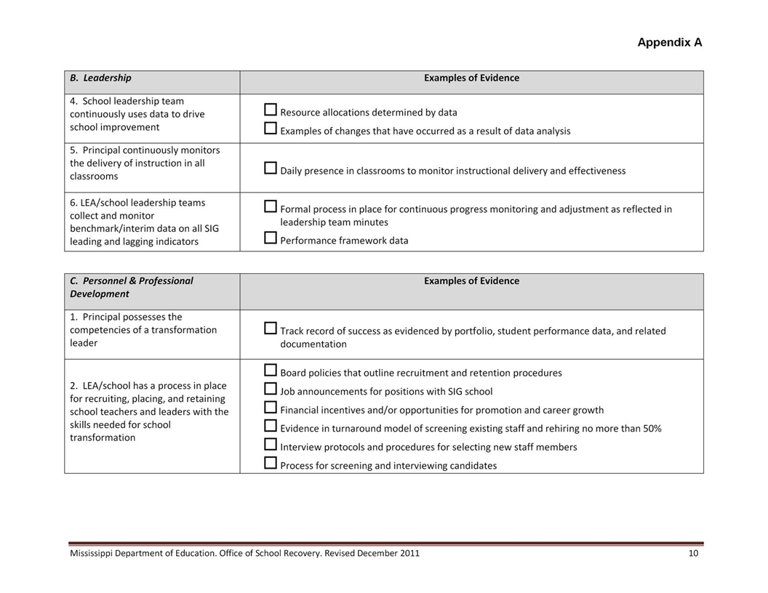
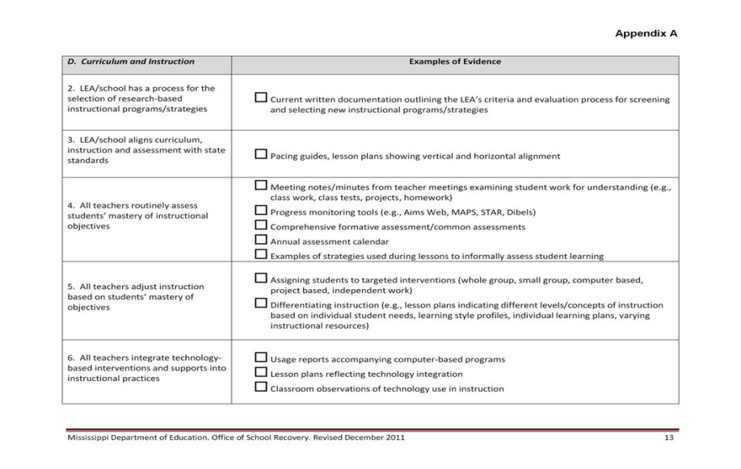
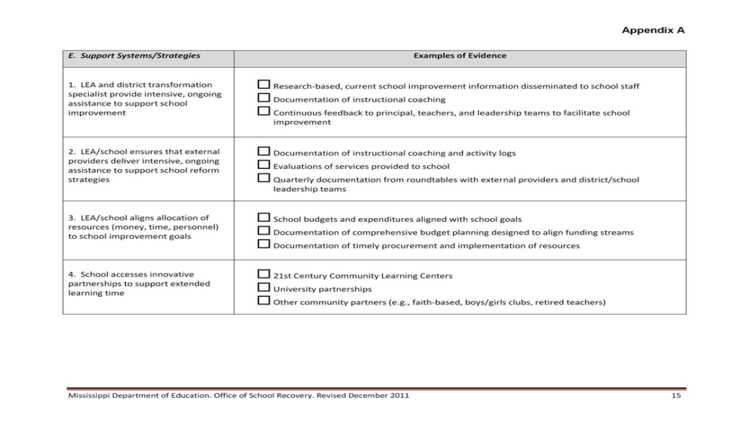
Indicators of Implementation
Notes:
Technical Assistance and Monthly Reports by OSR Staff
From year one, we learned the importance of providing continuous support to our schools – a blend of on-site, regional, webinars, electronic correspondence/phone calls –
The key to success, effectiveness rests with our contractual workers - implementation specialists. We have proven leaders who work diligently to establish a rapport with districts and schools with a balance of high expectations, encouragement and candor.
Indicators of Implementation – Framework, Foundation, Guiding Principles
48 indicators, state specific
5 key areas – Organization, Leadership, Personnel and Professional Development, Curriculum and Instruction, Support Systems and Strategies
Visits By Implementation Specialists
Reports
SEA Review
LEA / School Review
Actions to be Taken
Quarterly Reports
ARRA Financial Reports
Implementation Specialist Reports
External Provider Feedback

Slide 5
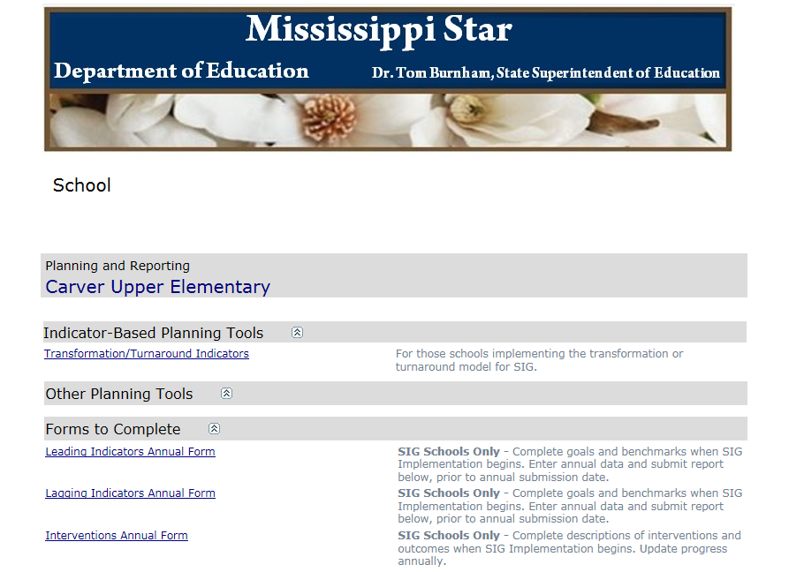
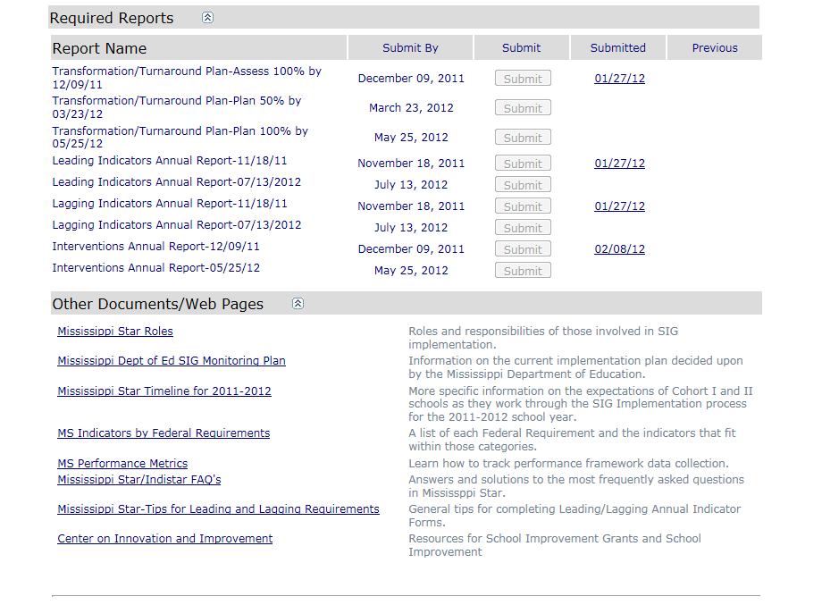
Notes:
Mississippi worked with the Center on Innovation and Improvement to design a state specific electronic platform to monitor and facilitate continuous school improvement at the school and district level – capacity / sustainability focused.
Four reports that are submitted annually –
Leading Indicators
Lagging Indicators
Interventions (Federal Requirements)
Transformation/ Turnaround Indicators – self-assess implementation of each indicator and provide evidence of implementation or drop down menu to create plan that leads the school to full implementation NEXT SLIDES (Timeline and Example of Report for Implementation)

Slide 6
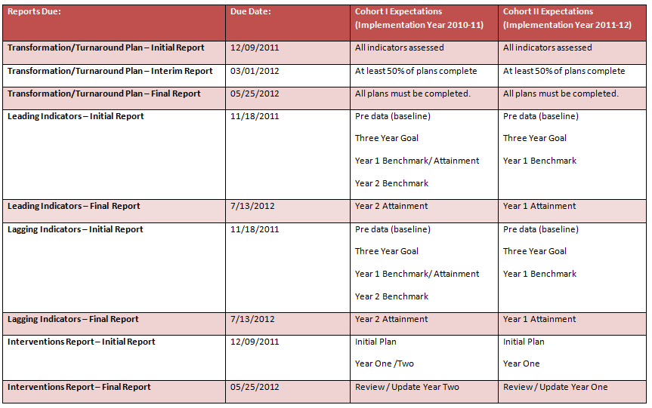
Reporting Timelines

Slide 7
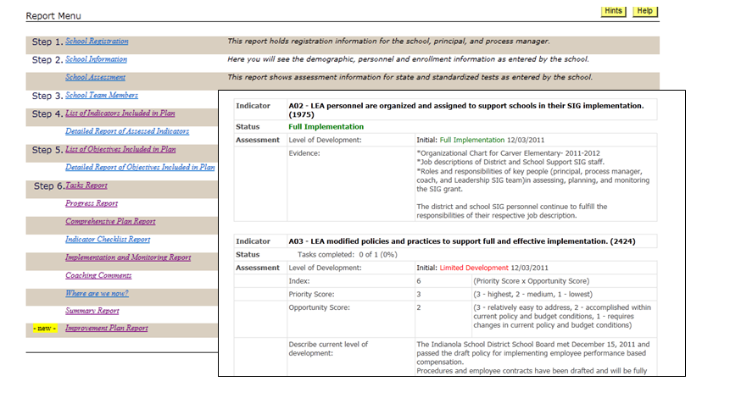
Notes:
Example of rating and drop-down forms for school leadership teams.
By increasing the capacity of LEAs and schools we can sustain school improvement efforts beyond SIG funding. With Mississippi Star we can…
Change conversations in schools
Empower leadership teams and administrators
Foster mutual accountability and ownership
Focus school improvement efforts
Link school improvement to research based actions
(Wise Ways and Indicators in Action)
Provide a “one-stop-shop” for improving schools

Slide 8
Annual Site Visit Summaries
Ratings in each area are based on information received from site visit interviews, observations, and documentation (e.g., site visit reports, district reports) provided by the district and school(s).
 |  | Not Addressed or No Evidence | Emerging/ Limited Evidence | Satisfactory Evidence Supported from Multiple Sources | Evidence Exceeds Standard | Extensive Evidence Aligned with Exemplary Implementation
I. IMPLEMENTATION - Organizational Structures |  | 1 | 2 | 3 | 4 | 5
1. | LEA/school conducted needs assessment to inform the SIG implementation plan | 1 | 2 | 3 | 4 | 5
2. | LEA makes structural changes to support implementation | 1 | 2 | 3 | 4 | 5
3. | LEA modifies policies and practices to support full and effective implementation | 1 | 2 | 3 | 4 | 5
Notes:
Annual Monitoring Review: Implementation Fidelity
Program
Fiscal
We based our monitoring protocol on the process used by USDE to monitor our SEA in year one. An external team conducts an on-site review over 2 days and rates indicators of implementation based on a synthesis of information acquired during site visit interviews, observations, and documentation (e.g., site visit reports, district reports) provided by the district and school(s).
Monitoring teams provide feedback and identify strengths and areas requiring further action. If an area is rated as 2, districts are to develop a plan of action in MS Star that is aligned to that specific indicator – “corrective action plan” or growth plan .
If time allows mention Wise Ways and Indicators in Action, Doing What Works

Slide 9
Evaluating Progress for Grant Renewal
SIG renewal decisions are based on whether the school has satisfied the following requirements in regards to its annual performance targets for leading and achievement indicators:
Leading Indicators—A school must meet 6 of 9 leading indicator goals.
Lagging Indicators (achievement indicators)—The school must also meet a minimum of 50% of applicable achievement indicators.

Slide 10
Leading Indicators
Number of minutes within the school year and school day
Student participation rate on State assessments in reading/language arts and mathematics, by subgroup
Dropout rate
Student attendance rate
Number and percentage of students completing advanced coursework
Discipline incidents
Truants
Distribution of teachers by performance level on an LEA’s teacher evaluation system
Teacher attendance rate
Lagging Indicators (achievement indicators)
School improvement status and AYP targets met and missed
Percentage of students at or above each proficiency level on State assessments in reading/language arts and mathematics, by grade and by student subgroup
Average scale score on State assessments in reading/language arts and mathematics, by grade, for the “all students” group, for each achievement quartile, and for each subgroup
Percentage of limited English proficient students who attain English language proficiency
Graduation rate
College enrollment

Slide 11
Exceptions are granted if extenuating circumstances occur. In making this determination, we consider the district/school’s implementation progress as reflected in the annual monitoring report, Mississippi Star reports, and implementation specialists' reports.
Year 1 Implementation | < 25% of indicators of implementation rated as Not Addressed or No Evidence
Year 2 Implementation | < 10% of indicators of implementation rated as Not Addressed or No Evidence
Year 3 Implementation | No indicators of implementation rated as Not Addressed or No Evidence
In addition to meeting the thresholds for implementation, districts and schools are expected to show a continuum of progress moving from emerging evidence of meeting implementation standards through satisfactory evidence of meeting implementation standards and into exceeding the standards.

Slide 12
Annual Goals
Performance Framework/ Comprehensive Needs Assessment from SIG Application
Mid-Year Report submitted to USDE via the EDEN (Education Data Exchange Network)
Leading/ Lagging Reports in Mississippi Star
Implementation Specialist Interim Data Checks
Notes:
Performance Framework/ Comprehensive Needs Assessment from SIG Application (BASELINE DATA)
Mid-Year Report submitted to USDE via the EDEN (Education Data Exchange Network)
Leading/ Lagging Reports in Mississippi Star ( 3 year goal, annual benchmarks)
Implementation Specialist Interim Data Checks (formative district assessments)

Slide 13
Annual Goals / Reporting Metrics
Notes:
At the state level we aggregate school level data to track progress for each leading and lagging indicator / reporting metric. We are in the process of moving from the “Paper-pencil” format to the electronic reporting in MS Star; our goal is to have the capability of getting this filtered/comprehensive report from the system rather than by hand – next step with CII partners.
This summative report allows for targeted professional development/ technical assistance, identification of effective/ineffective implementation practices; data driven decisions at the SEA level.
Evolving process – for example in year one we found inconsistencies with the reporting of teacher attendance and worked across the SEA to develop a consistent reporting mechanism for districts; teacher evaluation ratings – SIG and TIF have partnered and our schools will pilot the statewide system which will promote consistency in reporting.
Striving for clean, meaningful data to drive our TA and decisions.

Slide 14
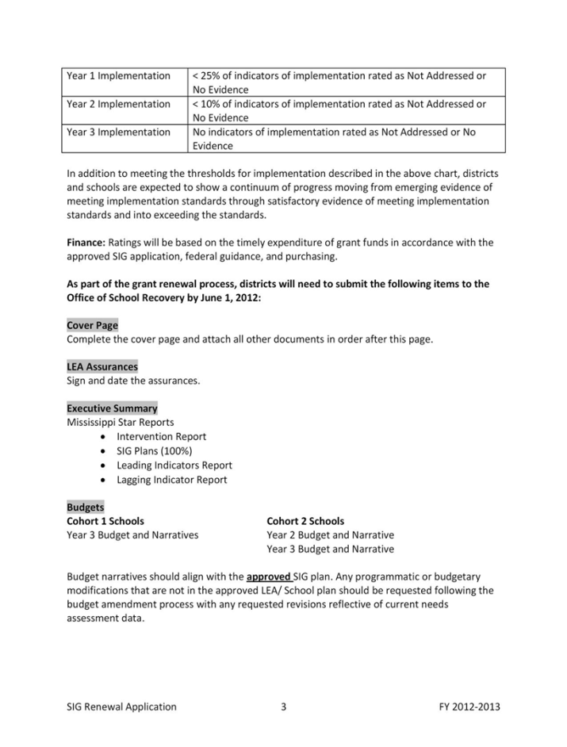
Grant Renewal Application
Link to Mississippi Star Reports
Notes:
We provide annual training for district and school level administrators –
This year we are aligning our process with MS Star – “connecting the dots”, aligning services/ resources

Slide 15
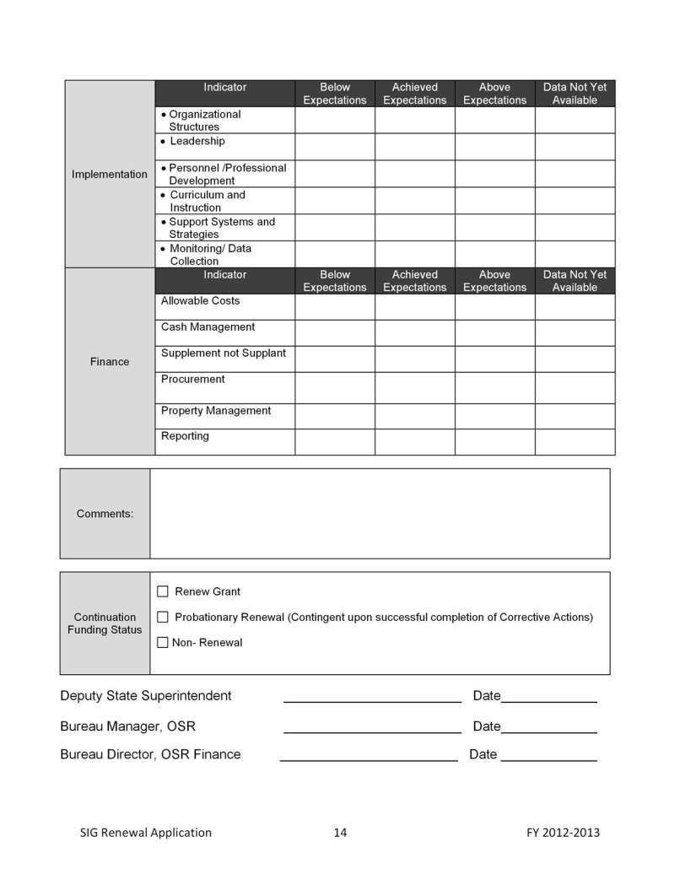
Grant Renewal SEA Checklist
Continuation Funding Status | Renew Grant Probationary Renewal (Contingent upon successful completion of Implementation Milestones and Corrective Actions) Non- Renewal

Slide 16
Contact Information:
Dr. Kim Benton, Office of School Recovery
Mississippi Department of Education
601-359-1003
kbenton@mde.k12.ms.us
http://www.mde.k12.ms.us/school_recovery/index.html

