Slide 1



How SEAs’ Statewide Systems of Support (SSOS) Build Systemic Capacity for LEAs and Schools
Featuring:
Tonya Middling, Washington Office of the Superintendent of Public Instruction
Pam VanHorn, Ohio Department of Education
Lauren Morando Rhim, Consultant for CII

Slide 2
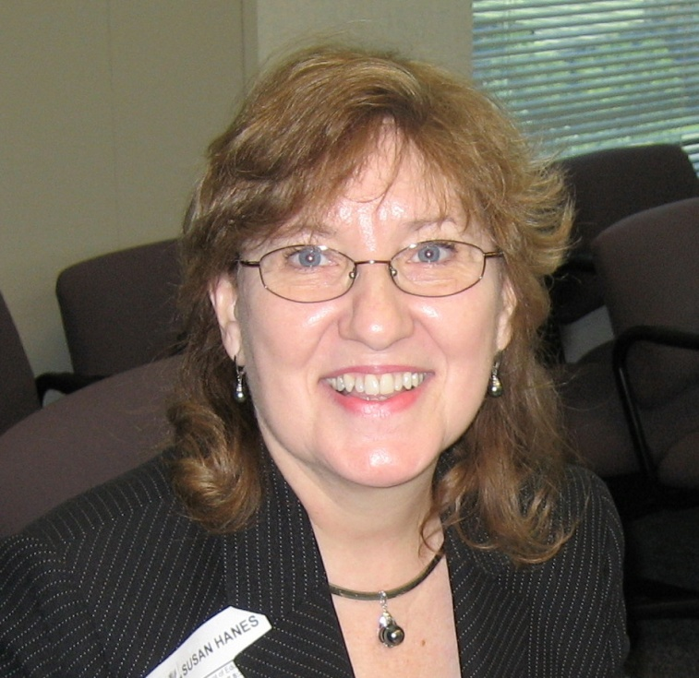
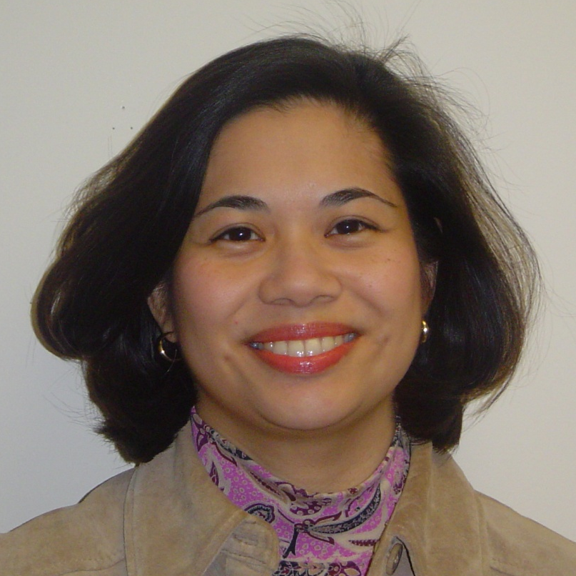
NNSSIL Co-coordinators
Susan Hanes
Technical Advisor, Center on Innovation and Improvement
Nina de las Alas
Senior Program Associate, Council of Chief State School Officers
Notes:
2

Slide 3
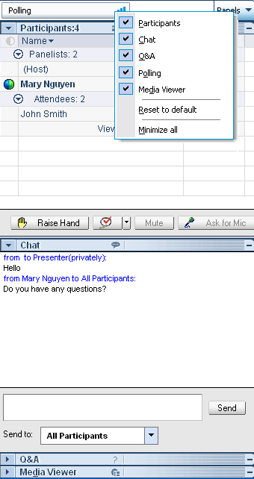
WebEx Panels & Features
Participants
Raise/lower hand
Chat
Q&A
Notes:
3

Slide 4
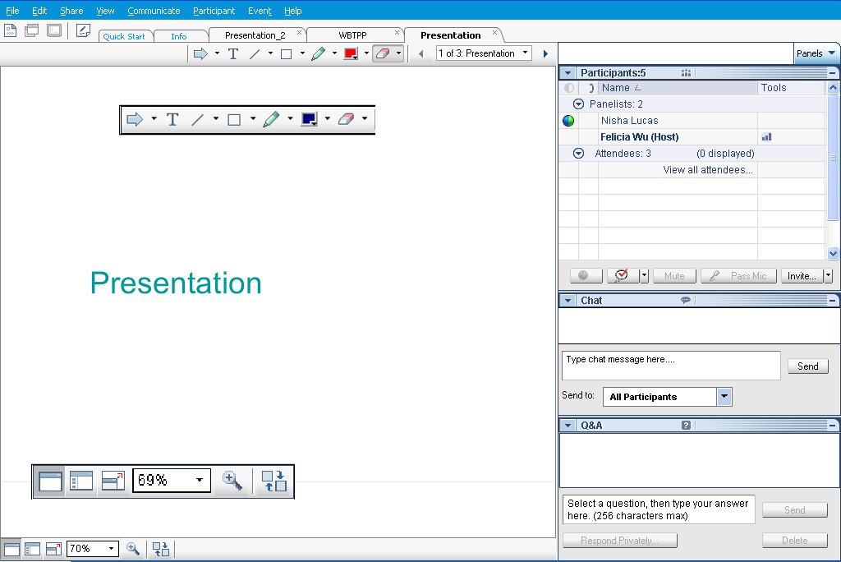
Webex Panels & Features
Presentations
Visual magnification
Audio volume (manual control through your phone or if using VOIP through computer’s audio controls . If you still cannot hear, please send Nina a chat message) or contact WebEx Tech Support (866-229-3239).
Notes:
4

Slide 5
National Network of State School Improvement Leaders (NNSSIL)
Vision
Network of state leaders engaged in developing an evidence-based body of knowledge that can lead to accelerating sustainable school, district and state improvement to raise educational results for all learners.
Mission
To provide collegial support among state leaders of school improvement to build, utilize and disseminate a robust body of knowledge of professional practices leading to systemic educational change.

Slide 6
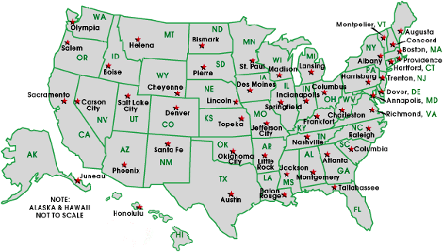
National Network of State School Improvement Leaders (NNSSIL)
Membership
50+ SEAs and territories
16 Regional Comprehensive
Centers (RCCs) & 5 Content
Centers
Advisory Group – Design Team
Subgroup of state reps., sub-dir.-level RCC
staffers, US ED, and NNSSIL co-coordinators
Administrative Partners
Center on Innovation & Improvement
Council of Chief State School Officers
More information: http://www.centerii.org/leaders

Slide 7
SEAs SSOS Building Capacity of LEAs, Schools
Purpose
Present Washington’s and Ohio’s approaches in SSOS, specifically
  Describe policies, procedures, and institutions involved in SSOS
  Describe how as a whole the system operates and builds LEAs and schools capacity for improvement
  Provide examples of tools and resources available
  Demonstrate differentiated supports
  Discuss how state budget shortfalls affect SSOS delivery
Provide highlights from an upcoming CII report that examines 9 states’ approaches to supporting dramatic school improvement
Share successes, lessons, learned and remaining challenges
Field questions from participants

Slide 8
Featured Presenters

Slide 9
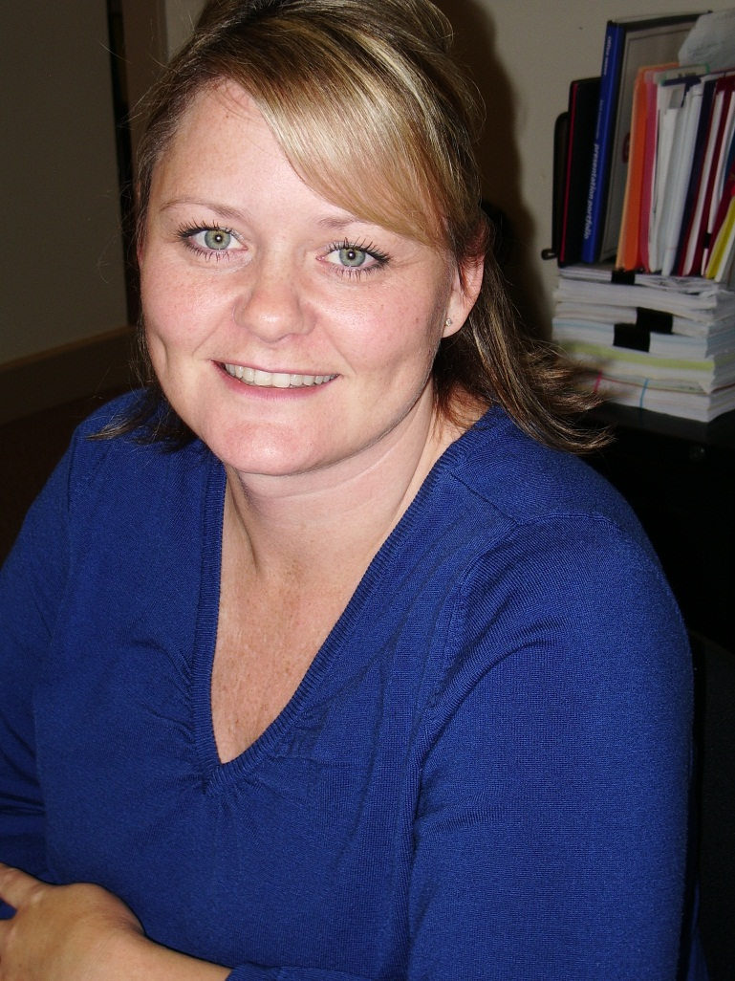
Featured Presenters
Tonya Middling
Director, of Project Development, Management and Implementation
Washington Office of the Superintendent of Public Instruction

Slide 10
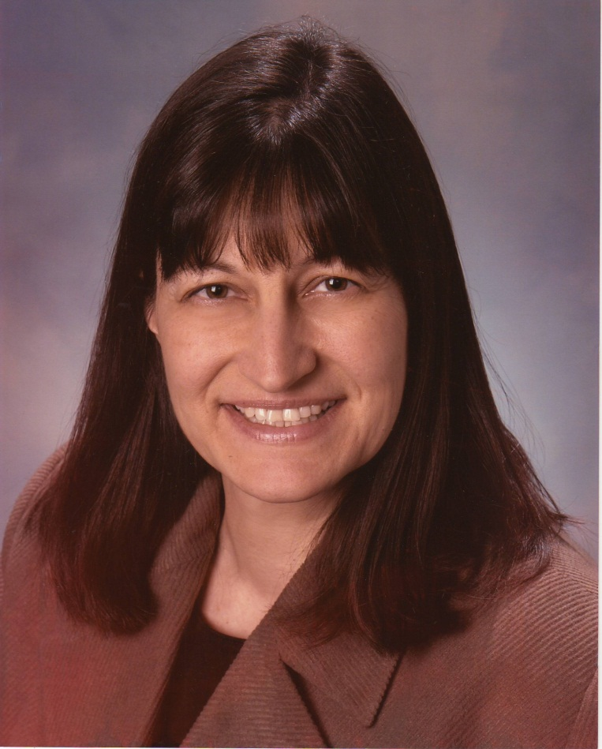
Featured Presenters
Pamela VanHorn
Director of the Office of State System of Support
Ohio Department of Education

Slide 11
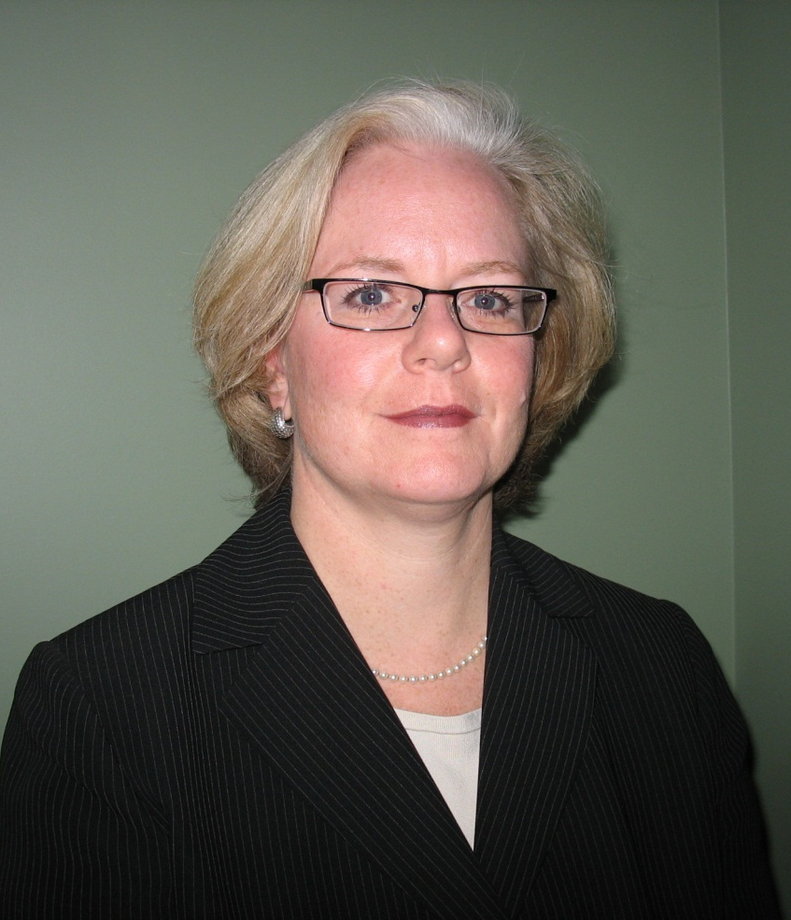
Featured Presenters
Lauren Morando Rhim
Consultant
Center on Innovation & Improvement

Slide 12
Q & A and Discussion

Slide 13
Q & A and Discussion
Please note that your phone line is muted upon entry and will remain muted (see red x in front of your name)
To get speakers’ attention, please use the “Raise Hand” button in the Participants Panel. We will un-mute then.
You can also post your questions or comments on the Q & A Panel.
Notes:
13

Slide 14
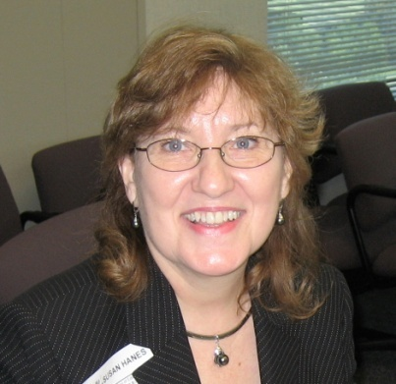
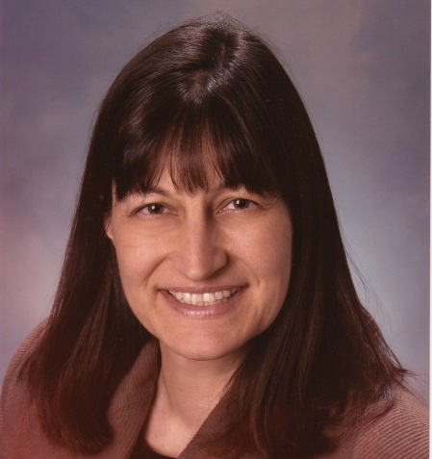
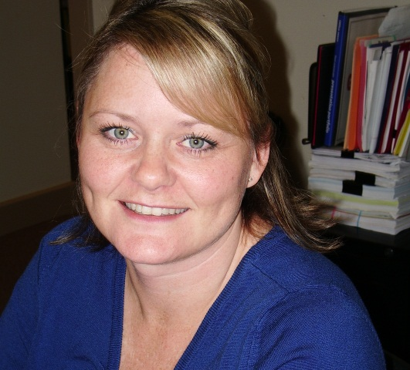
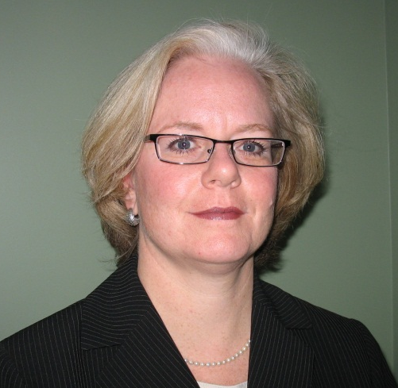
Panelists
Susan Hanes
NNSSIL Co-Coordinator/
Moderator
Pam VanHorn
Ohio DOE
Lauren Morando Rhim
Consultant for CII
Tonya Middling
Washington OSPI
Notes:
14

Slide 15
For More Information www.centerii.org/leaders
Link to this webinar’s recording, slides and resources mentioned during the presentations
Feedback
Follow-up questions? Send to Susan Hanes, shanes@centerii.org

Slide 16

Thank you to our featured presenters and thank you all for participating in today’s webinar!
Notes:
16

