Slide 1
Building Effective Leadership Teams: A Practitioner’s Look

Slide 2
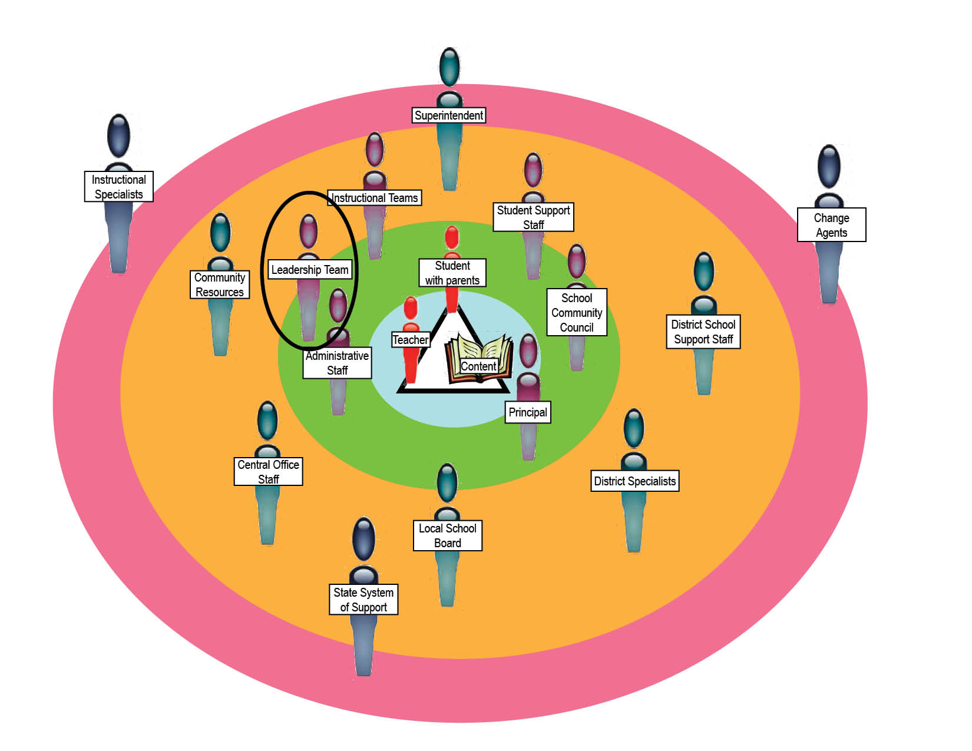
Leadership Teams

Slide 3
The Essential Supports for School Improvement ; Consortium on Chicago School Research, 2006: http://ccsr.uchicago.edu

Slide 4
Leadership Team (LT)
What is the Leadership Team?
Goal Setting
Resource Management
Leadership Team
Shared Leadership

Slide 5
Goal Setting
The principal and leadership team collaborate to establish and communicate instructional goals for school success.
The principal leads the school community in creating and revising a vision for the school that is informed by the community context.
The leadership team sets high expectations for teaching, learning, and leading and fosters an environment where staff are free to take risks.
The principal and leadership team are knowledgeable about instructional best practices and research; they expect and support high-quality instruction in every classroom

Slide 6
Resource Management
The leadership team allocates and manages resources to support the school’s instructional program.
The leadership team effectively allocates and manages the school’s resources – people, time, funds, and materials – to address school priorities and students’ needs.
The school community evaluates and plans school programs and policies based on their contribution toward reaching school goals.
Teachers use other staff, classroom volunteers, and family resources at home to maximize the amount of individualized instruction students receive.

Slide 7
Shared Leadership
School staff share leadership responsibilities and participate in decision making that advances the school’s mission.
The leadership team empowers staff and holds them accountable for results, developing a plan for leadership succession.
Teachers and students assume leadership roles outside of the classroom, actively participate in the school improvement process, and take ownership of resulting setbacks and successes.
The leadership team reflects the varied perspectives in the school; the principal taps into staff members’ interests and areas of expertise to strengthen school programs.

Slide 8
Change Agent Role: a skilled community coordinator is the key to developing an effective community of practice, * (Wenger, McDermott & Snyder, 2003)
Identify important issues to focus the ILT’s work
Plan and facilitate ILT events/activities
B
Informally link ILT members in order to broker knowledge exchanges
Manage the boundary between the ILT and the faculty/school
C
Build the practice for group learning knowledge base, lessons learned, best practices, tools and methods, and learning events
Assess the health of the ILT and its contribution to the school and the members.
Foster individual learning
A

Slide 9
School Leadership
Principal & Change Agent
K-5 Team Leads
Counselor & Family Resource Center
Content Coordinators
School Administrative Manager

Slide 10
The School-Level Strategy
School Leadership Team
Set Standards & Expectations for Leadership
Supervision & Monitoring of Instruction
Use Data for Planning & Accounting
Engage Families & Community
Provide Research-Based & Effective Instruction in Support of State and District Standards
Support Instruction in the Classroom

Slide 11
Setting Expectations for Achievement
First learning expectations
Review available data
Make connection for establishing goal for improving student achievement
Establish curriculum benchmarks
Discuss formative, interim and summative assessment strategies

Slide 12
Providing Research-Based and Effective Instruction in Support of State and District Standards
Use Program of Studies and Core Curriculum Map
Grade-level team discussion/selection of research-based intervention programs in reading and math (to best support lower achieving students)
Discussion/selection of research-based programs to best support higher achieving students

Slide 13
Supporting Instruction in the Classroom
Attend weekly collaborative team meetings
Analyze student work and student data
Develop an intervention program using research-based materials
Fund professional development for embedded PD within the building
Allocate funding for specific instructional goals
Schedule daily common planning times

Slide 14
Supervision and Monitoring of Instruction
Principal makes routine classroom visits to observe instruction and feedback
Teachers participate in peer observation and feedback
Teachers participate in collaborative teaching
and assessment
Principal routinely reviews lesson plans and provides feedback

Slide 15
Engaging Families and Community
Send academic achievement reports to parents regarding their child’s progress
School sends home monthly publication to families and community
Classroom teacher send home weekly newsletter and/or reports
Develop online interactive webpage for information
Coordinate monthly activities to bring families and community into the building

Slide 16
Using Data for Planning and Accountability
Use multiple data sources to identify academic achievement gaps
Use Classroom Assessment System & Community Access Dashboard for Education (CASCADE) and other assessment tools to ascertain achievement levels, determine benchmarks, appropriate intervention, and redirect instructional strategies

Slide 17
The Next Level of LT Weekly Collaborative Team Meetings
Use of evidence on student performance has moved to:
Analysis of student learning patterns
Higher order questions abut why particular instructional practice are or are not working
Discussions about teaching and learning are grounded in evidence and analysis; rather than opinion and preconceptions
Shift accountability from the individual teacher to the teaching community

Slide 18
Turning Around Low-Performing Schools: Planning Template for Working With Schools
* Do What Works from the Department of Education

Slide 19
Activity
How would you use Leadership Teams with a strong principal?
How would you use Instructional Leadership with a strong principal?

